Slide 1
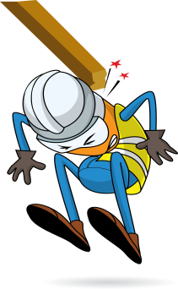
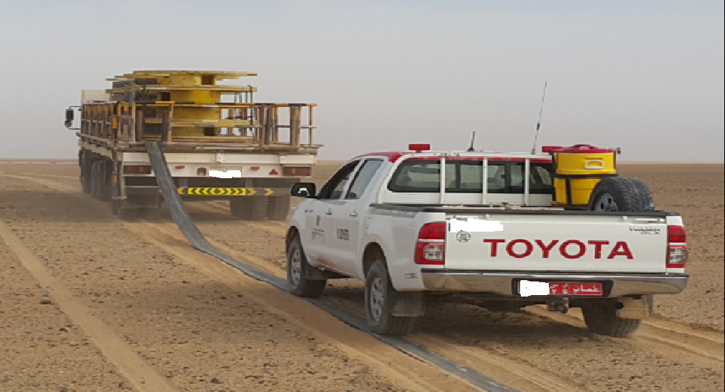
PDO Incident First Alert
Incident type | LTI (#14a)
Date/ time | 10.05.2017 at 11:40 hrs. | Directorate
Location | Ufuq field, Lekhwair | Dept
What happened
While the HDU (Hose Deployment Unit) crew was laying hoses from a slow moving HDU trailer, the hose got stuck at the hose reel. As the trailer kept moving forward, the hose released from the reel hitting the technician causing him to fall landing on his right arm resulting in a fracture.
Mr. Musleh asks the questions of can it happen to you?
Are you using defective equipment instead of getting it repaired?
How do you effectively communicate between driver and workers?
Do you ensure you are away from “Line of Fire”?
Do you consider “what could go wrong?”
Please disseminate this LTI notification to your teams and use it in your tool box talks and HSE meetings and notice boards.

