Slide 1
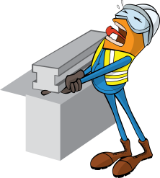
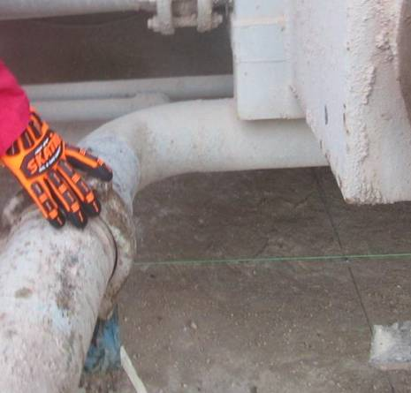


PDO Incident First Alert
Incident type | LTI (#15)
Date/ time | 15.05.2017 at 18:35 hrs. | Directorate
Location | Rig 31 Saih Rawl | Dept
What happened
A forklift was lifting up the 6” line to connect to the Shale Shaker cuttings box whilst the roustabout was hand tightening the hammer union connection. While doing so, the Roustabout encountered difficulties connecting the line and started to push it with his thigh causing the line to move towards the cutting box crushing his finger against the edge.
Mr. Musleh asks the questions of can it happen to you?
Do you stop and ask for help when needed?
Do keep your hands and fingers away from crush points?
Do you ensure you are away from “Line of Fire”?
Direction of pipe movement
Please disseminate this LTI notification to your teams and use it in your tool box talks and HSE meetings and notice boards.

