Slide 1
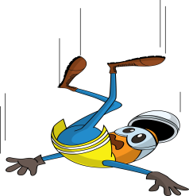


PDO Incident First Alert
Incident type | LTI (#16)
Date/ time | 21.05.2017 at 18:00 hrs. | Directorate
Location | Karim Small Fields | Dept
What happened
The Crane operator was climbing into the crane cabin. On reaching the 3rd step he lost his balance falling to the ground resulting in a fracture to his right wrist and neck.
Mr. Musleh asks the questions of can it happen to you?
Do you always keep 3 points of contact when climbing in and out of the cabin?
Do you always consider how you can fall from height?
Do you use always pay attention when climbing up to a vehicle?
Please disseminate this LTI notification to your teams and use it in your tool box talks and HSE meetings and notice boards.

