Slide 1
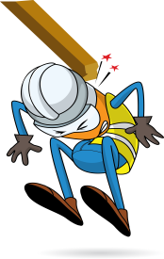
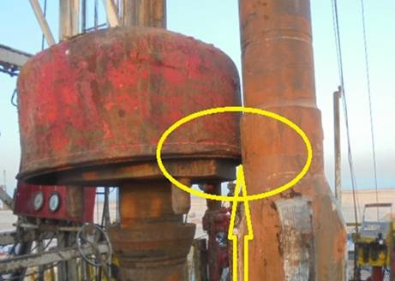


PDO Incident First Alert
Incident type | LTI (#17)
Date/ time | 26.05.2017 at 18:25 hrs. | Directorate
Location | Rima - Bahja | Dept
What happened
The Kelly was suspended on the rig floor by the hook while the motor was lifted, two floorman were guiding the motor using their hands. The Kelly moved toward the motor crushing the floorman's right hand against the motor fracturing his middle finger.
Mr. Musleh asks the questions of can it happen to you?
Do you ensure all lifting operations procedures are adhered to?
Do you always assess the risks when you change your work plans?
Do you always keep away from the “Line of Fire”?
Do you always used the right type of gloves for the work?
Crush point
Please disseminate this LTI notification to your teams and use it in your tool box talks and HSE meetings and notice boards.

