Slide 1
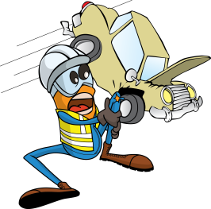
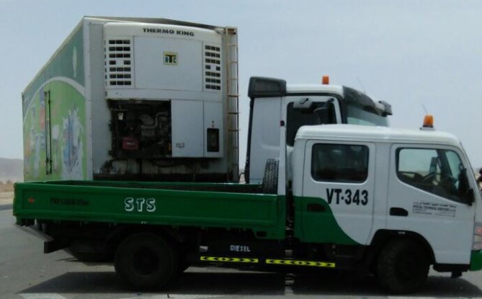
PDO Incident First Alert
Incident type | LTI (#18)
Date/ time | 05.06.2017 at 11:45 hrs. | Directorate
Location | Qarn Alam | Dept
What happened
A canter was travelling from Adam to Qarn Alam when the driver decided to turn left from the main road. A 3rd party truck travelling behind him collided with the left side of the canter resulting in damage to the vehicle and a fracture to the drivers left collar bone.
Mr. Musleh asks the questions of can it happen to you?
Do you always check your blind spot and mirror when turning?
Do you follow your defensive driving techniques?
Do you continue driving if you are fatigued?
Please disseminate this LTI notification to your teams and use it in your tool box talks and HSE meetings and notice boards.

