Slide 1
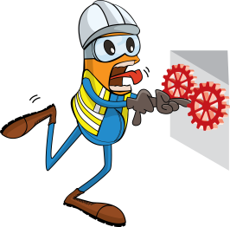
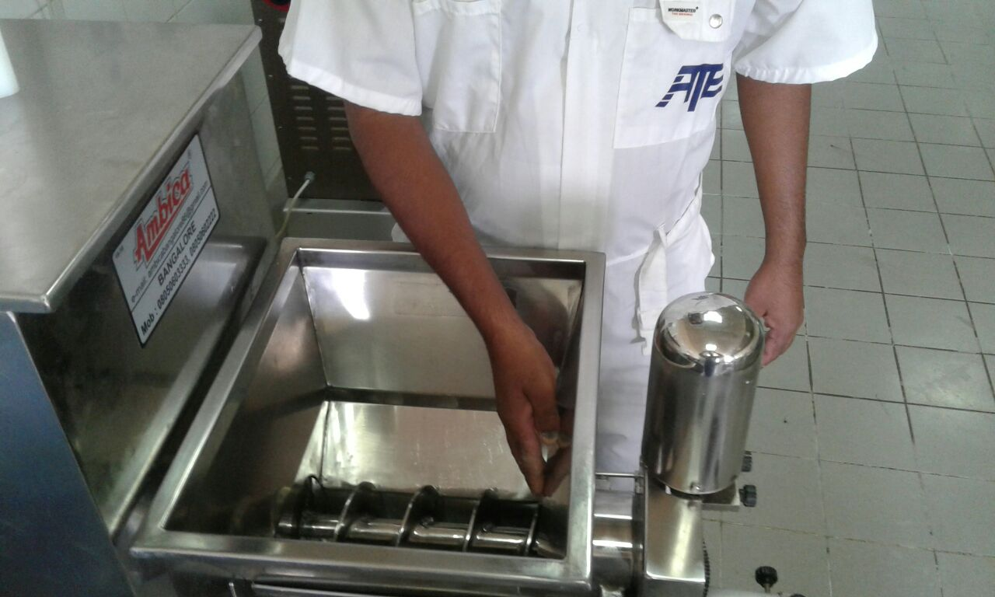


PDO Incident First Alert
Incident type | LTI (#19)
Date/ time | 13.06.2017 at 11:05 hrs. | Directorate
Location | Harweel | Dept
What happened
Whilst preparing chapatti mix a cook noticed some of the mix sticking to the side walls of the hopper and decided to pushed it down with his right hand without switching the machine off. Whilst doing this his right thumb and index finger became entangled between the rotating blade and hopper body amputating both his finger and thumb.
Mr. Musleh asks the questions of can it happen to you?
Do you ensure that guards and covers are in place on machinery?
Do you always use push sticks?
Do you consider if you are ever in the ‘line of fire’?
Please disseminate this LTI notification to your teams and use it in your tool box talks and HSE meetings and notice boards.

