Slide 1
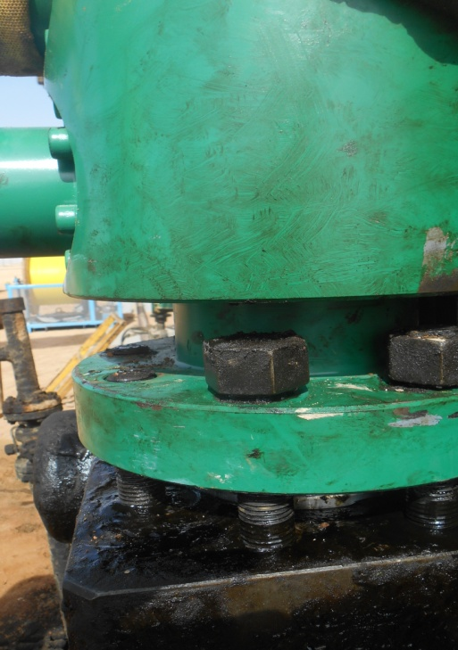
PDO Incident First Alert
Incident type | LTI (#20)
Date/ time | 15.06.2017 at 08:30 hrs. | Directorate
Location | Nimr | Dept
What happened
While installing the BOP which was joined to winch, three group part were holding the BOP to fix it on the X-tree as two individuals pushing, IP was pulling. His right hand got slipped from the BOP, gone into the gap and got pinched by the stud causing a fracture on his ring finger.
Mr. Musleh asks the questions of can it happen to you?
Do you ensure you keep your hands away from pinch points?
Do you always use the correct lifting procedure?
Do you ensure good communication with your team mates?
Please disseminate this LTI notification to your teams and use it in your tool box talks and HSE meetings and notice boards.

