Slide 1
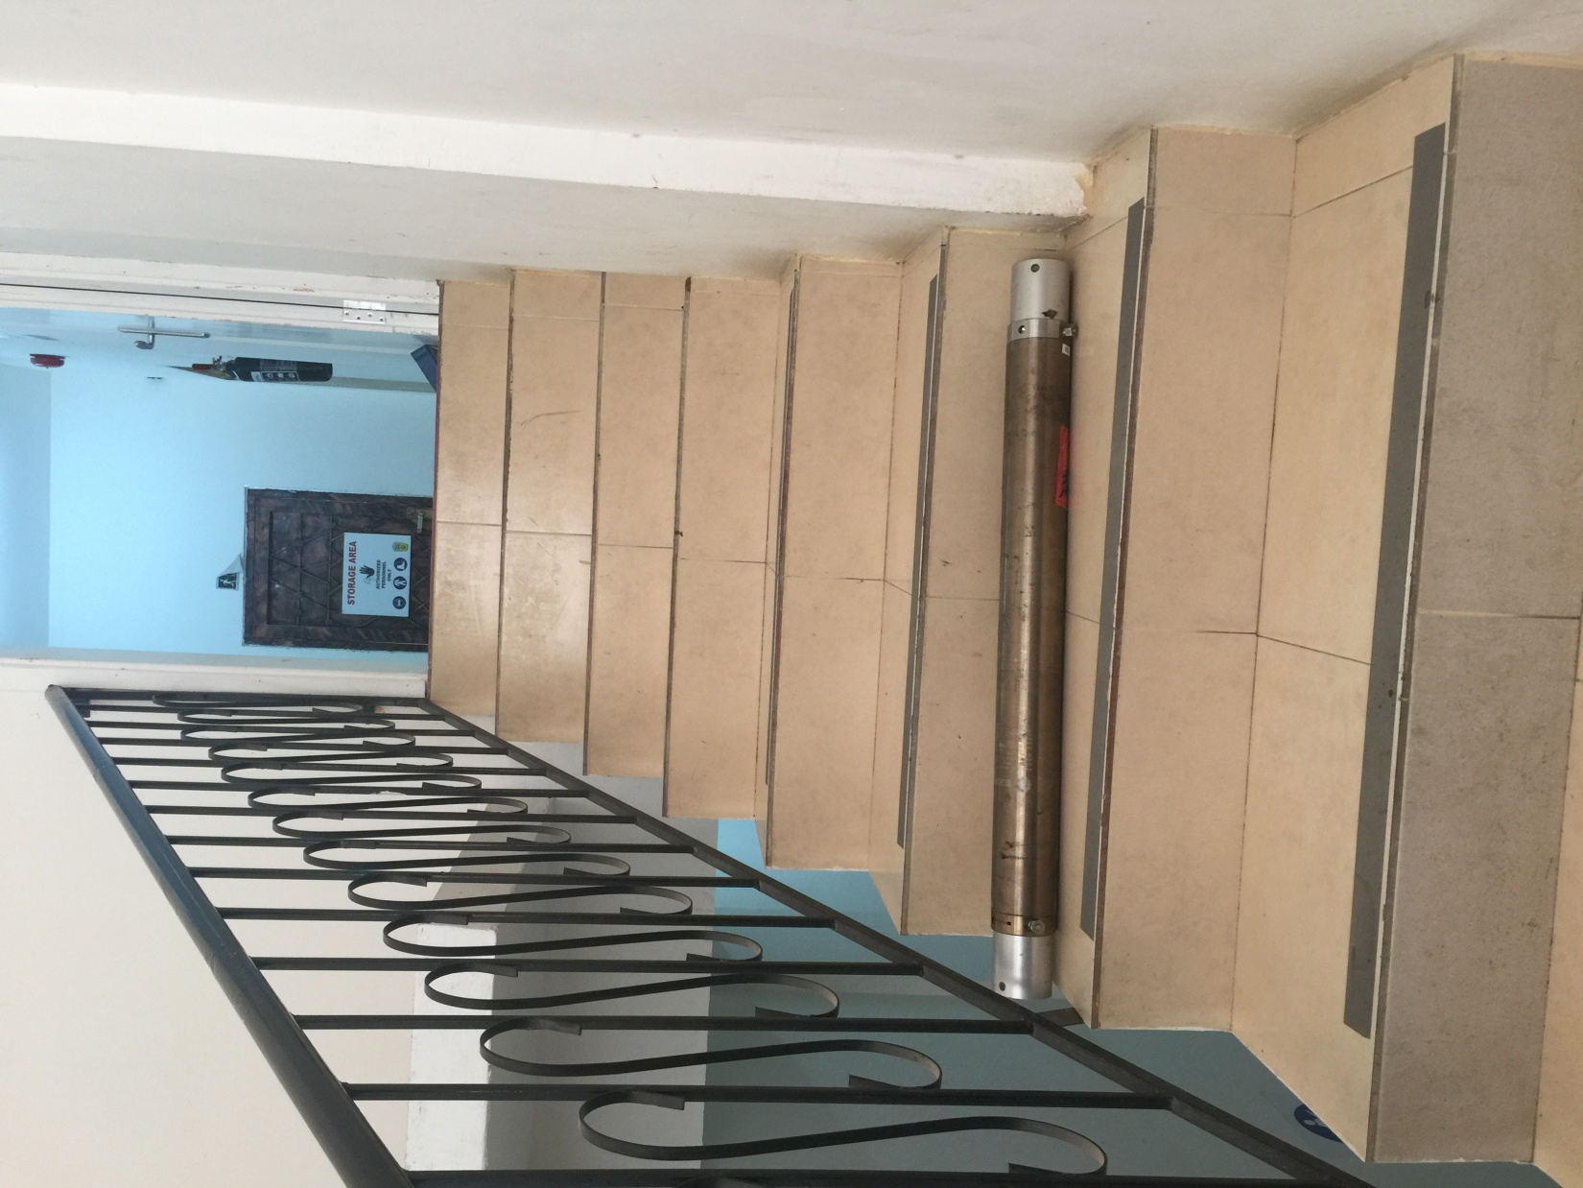
PDO Incident First Alert
Incident type | LTI (#22)
Date/ time | 22.06.2017 at 10:30 hrs. | Directorate
Location | Muscat | Dept
What happened
While carrying an empty steel cylinder (25kg) up a staircase, a Lab Engineer slipped losing his balance landing badly on the stairs resulting in multiple cut wounds.
He was taken to a local clinic for first aid treatment before being referred to Khoula Hospital where an X-ray revealed a fracture to his left hand ring finger.
Mr. Musleh asks the questions of can it happen to you?
Do you always ensure use the correct lifting procedure?
Do you always use handrails while using stairs?
Do you coordinate activities with your work colleagues?
Foot slipped on stair
Please disseminate this LTI notification to your teams and use it in your tool box talks and HSE meetings and notice boards.

