Slide 1
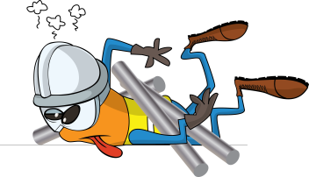
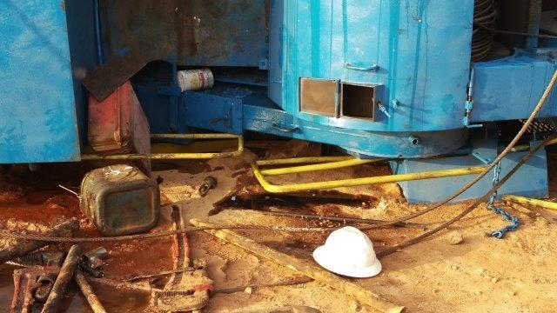


PDO Incident First Alert
Incident type | LTI (#23)
Date/ time | 30.06.2017 at 02:00 hrs. | Directorate
Location | Nimr Small fields | Dept
What happened
While the driller was rigging down the hoist, the unit (rig carrier and mast) tipped over onto one side, trapping his right leg between the hand rail and the ground resulting in a fracture to his right leg.
Mr. Musleh asks the questions of can it happen to you?
Do you always ensure stable conditions for lowering the mast?
Do you always ensure workers are in a safe place while lowering the mast?
Do you always consider if you are in the line of fire?
Location where the driller was trapped
Please disseminate this LTI notification to your teams and use it in your tool box talks and HSE meetings and notice boards.

