Slide 1
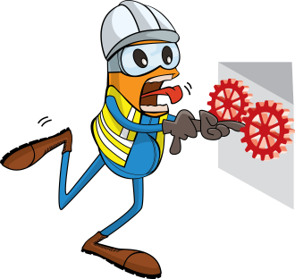
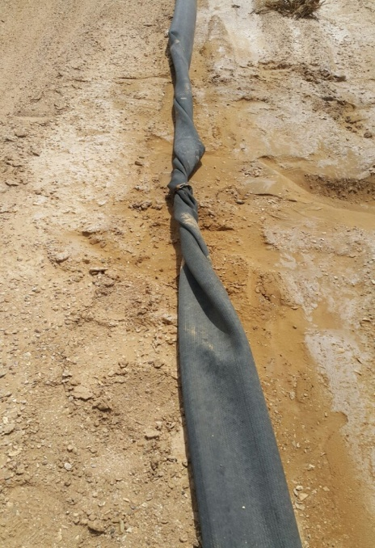



PDO Incident First Alert
Incident type | LTI (#24)
Date/ time | 08.07.2017 at 0935 hrs. | Directorate
Location | Natih field, Fahud | Dept
What happened
The Drill Water Service crew was checking the water hose when they discovered a significant twisting of the hose line. While the helper was next to the line the water pressure caused a release of energy entangling his left arm in the hose resulting in multiple fractures to his upper and lower left arm and fingers.
Mr. Musleh asks the questions of can it happen to you?
Do you ensure the water pump is off before attempting to straighten the hose?
Do you ensure good communication between team members?
Do you consider “what could go wrong?”
Do you ensure you are out of the “Line of fire”
Left hand/arm entangled with hose
Please disseminate this LTI notification to your teams and use it in your tool box talks and HSE meetings and notice boards.

