Slide 1
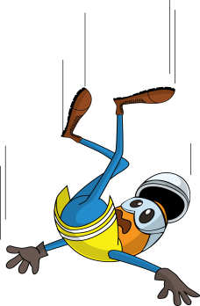
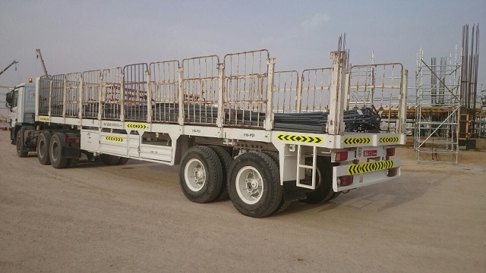
PDO Incident First Alert
Incident type | LTI (#25)
Date/ time | 20.07.2017 at 17:15 hrs. | Directorate
Location | Yibal Khuff | Dept
What happened
A Steel Fixer was off loading bundles of steel rods while on the back of a trailer when a loud noise startled him causing him to jump off the trailer landing on his right hand causing a fracture to his right wrist.
Mr. Musleh asks the questions of can it happen to you?
Do you ensure you have a safe access and egress?
Do you consider what can go wrong while working at height?
Please disseminate this LTI notification to your teams and use it in your tool box talks and HSE meetings and notice boards.

