Slide 1
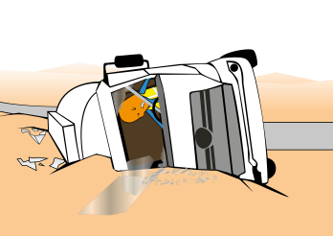
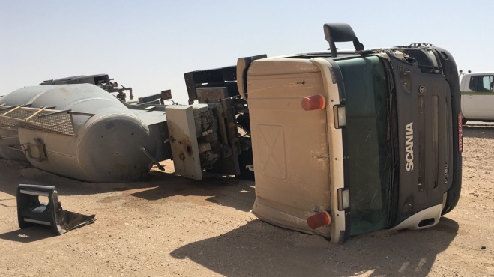
PDO Incident First Alert
Incident type | LTI (#26)
Date/ time | 03.08.2017 at 14:30 hrs. | Directorate
Location | Rima | Dept
What happened
While mobilizing a cement tanker on a blacktop road from Nimr towards Hoist 18, both rear tyres burst causing the driver to loose control of the vehicle rolling over to the right. He was referred to Nizwa Hospital where an X-ray revealed a fracture to his pelvis.
Mr. Musleh asks the questions of can it happen to you?
Do you ensure you check your tyres before driving?
Do you report all vehicle defects immediately?
Do you ensure to follow the speed limits on the blacktop roads?
Please disseminate this LTI notification to your teams and use it in your tool box talks and HSE meetings and notice boards.

