Slide 1
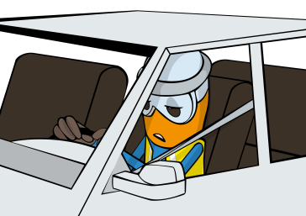
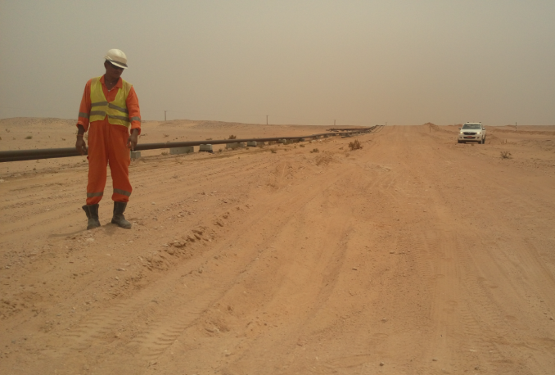


PDO Incident First Alert
Incident type | LTI (#27)
Date/ time | 20.07.2017 at 11:15 hrs. | Directorate
Location | Rahab Field Marmul | Dept
What happened
While travelling on a graded road from Rahab field to Marmul, the driver passed over a section of uneven road causing the vehicle to bounce resulting in severe back pain.
Mr. Musleh asks the questions of can it happen to you?
Do you ensure you follow graded road defensive driving techniques?
Do you ensure you receive adequate information about the road conditions from the Journey Manager prior to starting your journey?
Do you report all vehicle defects immediately?
Do you ensure to follow the speed limits on graded roads?
Uneven road conditions
Please disseminate this LTI notification to your teams and use it in your tool box talks and HSE meetings and notice boards.

