Slide 1
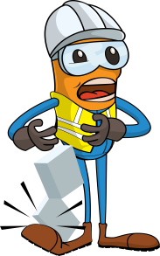
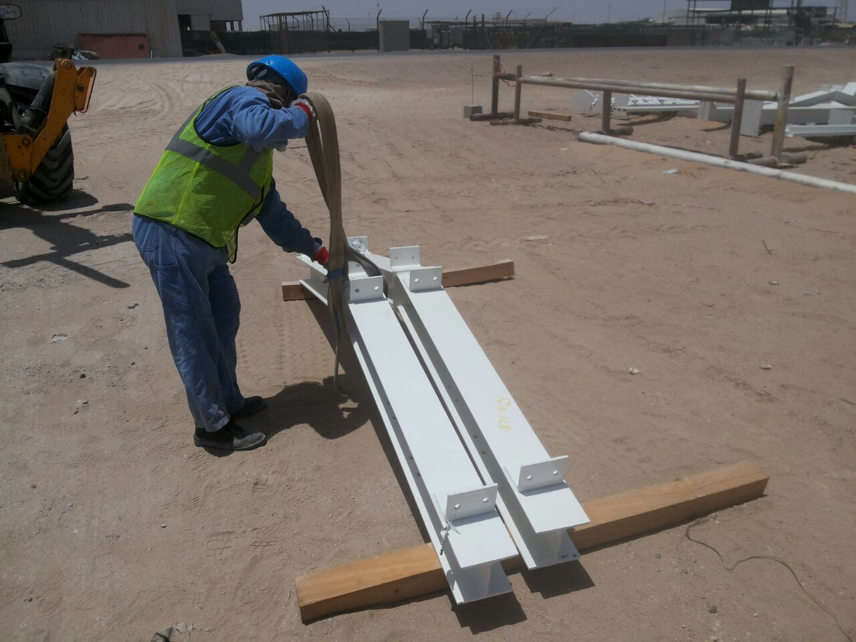


PDO Incident First Alert
Incident type | LTI (#28)
Date/ time | 13.08.2017 at 16:30 hrs. | Directorate
Location | Qarn Alam | Dept
What happened
During fabrication of a shade, a rigger was fitting a sling around a beam for lifting when the beam became unbalanced causing it to fall over onto his left foot fracturing two of his toes
Mr. Musleh asks the questions of can it happen to you?
Do you always use the correct lifting method?
Do you ensure that you are stood in a safe place?
Do you ensure you ask for help when you need it?
Do you ensure you are out of the “Line of fire”?
Direction of fallen object
Please disseminate this LTI notification to your teams and use it in your tool box talks and HSE meetings and notice boards.

