Slide 1
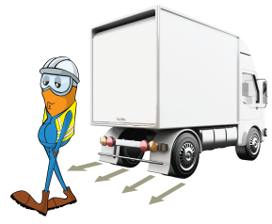
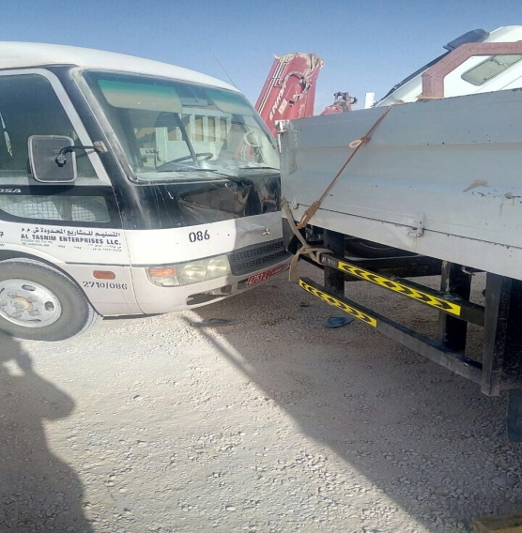
PDO Incident First Alert
Incident type | LTI (#31)
Date/ time | 18.08.2017 at 06:45 hrs. | Directorate
Location | Marmul | Dept
What happened
A mechanic was walking between a Hiab truck and a bus in the AL-Turki camp when a Hiab, that was under maintenance inadvertently rolled backward trapping the mechanic between the bus and the Hiab resulting in a crush injury to his chest and abdomen.
Mr. Musleh asks the questions of can it happen to you?
Do you ensure vehicles hand brake is applied and chocks in place?
Do you ensure you use a safe path when walking between parked vehicles?
Do you consider what can go wrong?
Do you ensure you stay out of the “Line of Fire”?
Crush point between two vehicles
Please disseminate this LTI notification to your teams and use it in your tool box talks and HSE meetings and notice boards.

