Slide 1
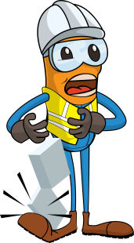
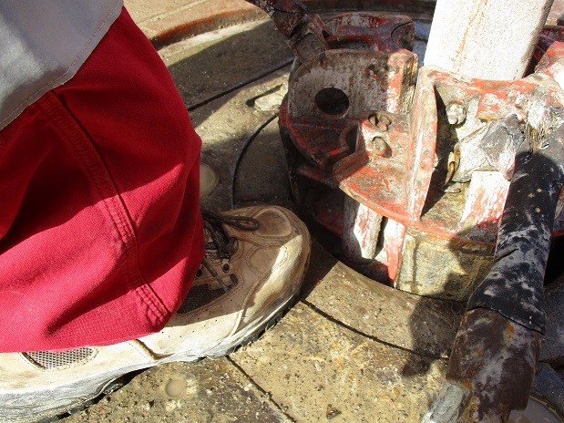
PDO Incident First Alert
Incident type | LTI (#32)
Date/ time | 27.08.2017 at 23:21 hrs. | Directorate
Location | Amal West | Dept
What happened
While drilling 12 ¼” top hole, while moving the slips into position to make a connection with the drill pipe, the Floorman pushed the slips with his left foot at the same time the Driller slackened off the drill string resulting in the Floorman’s foot being caught between the rotary table and the slips resulting in a fracture to his left big toe.
Mr. Musleh asks the questions of can it happen to you?
Do you consider pinch points?
Do you ensure good communication and coordination with your colleagues?
Can this be done with mechanical aids?
Do you ensure you stay out of the “Line of Fire”?
Crush point between below the slips
Please disseminate this LTI notification to your teams and use it in your tool box talks and HSE meetings and notice boards.

