Slide 1
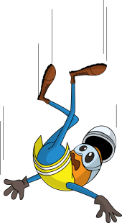
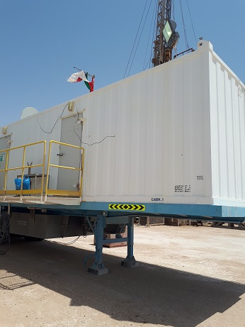
PDO Incident First Alert
Incident type | LTI (#33)
Date/ time | 31.08.2017 at 13:30 hrs. | Directorate
Location | WHP-50 Fahud | Dept
What happened
While the Electrician was working on top of the Rig managers cabin without fall protection, he lost his balance falling 4.3 meters to the ground fracturing his right wrist.
4.3meters
Mr. Musleh asks the questions of can it happen to you?
Do you always ensure you are protected from a fall from height?
Do you ensure you are in a safe position when working at height?
Have you asked how you are to access height safely?
Do you plan the job beforehand to avoid a dangerous activity?
Please disseminate this LTI notification to your teams and use it in your tool box talks and HSE meetings and notice boards.

