Slide 1
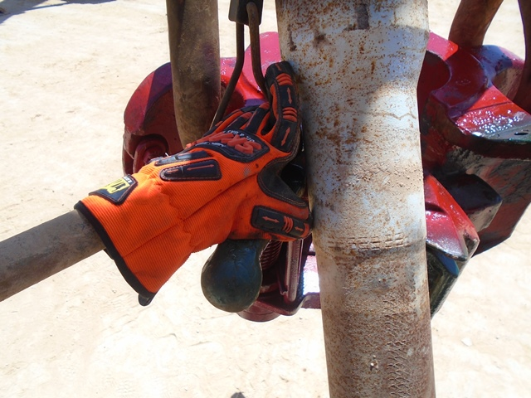
PDO Incident First Alert
Incident type | LTI (#34)
Date/ time | 01.09.17 at 05:45hrs | Directorate
Location | Rig 38 Marmul | Dept
What happened
While Running in the hole 5'' drill pipe, the Floorman attempted to push the drill pipe into the elevator, his left hand was caught between the elevator handle and pipe resulting in a crush injury, fracturing his left thumb.
Mr. Musleh asks the questions of can it happen to you?
Do you ensure you keep your hands and fingers away from pinch points?
Do you consider what could go wrong?
Do you ensure you are out of the “Line of fire”?
Crush point
Please disseminate this LTI notification to your teams and use it in your tool box talks and HSE meetings and notice boards.

