Slide 1
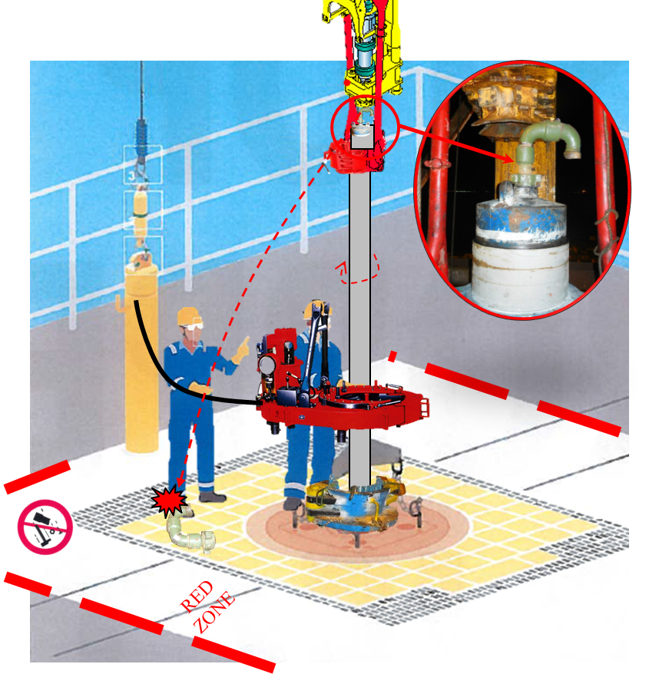
PDO Second Alert
Date: 18.01.17 Incident Type: LTI
What happened?
While two casing running company operators were making up 18.5/8’’ casing landing joint, a chiksan swivel joint (24kg) which was connected on top of the casing circulating head got unscrewed and fell from 13 meters in between the two operators and hit on the right foot of one of the operators.
Your learning from this incident..
Ensure that red zone compliance is strictly followed even during slower repetitive block movement activities ie casing running.
Ensure clearance between TDS and the circulating head swivel, longer TDS links / bails for casing jobs to be used.
Wherever any object can potentially Drop from height, it must have a secondary retention.
Always use secondary retention

Slide 2
Management self audit
Date: 18.01.17 Incident Type: LTI
As a learning from this incident and to ensure continual improvement all contract managers must review their HSE HEMP against the questions asked below
Confirm the following:
Are you using the right equipment and tools to eliminate the risks and hazards?
Are you installing secondary retention to all items which can potentially DROP?
Are you learning from Previous incidents and sharing with the crew?
Are you intervening at the right time to STOP unsafe behaviors?
Are you ensuring that employees are following procedures?
Notes:
Make a list of closed questions (only ‘yes’ or ‘no’ as an answer) to ask other contractors if they have the same issues based on the management or HSE-MS failings or shortfalls identified in the investigation. Pretend you have to audit other companies to see if they could have the same issues.

