Slide 1
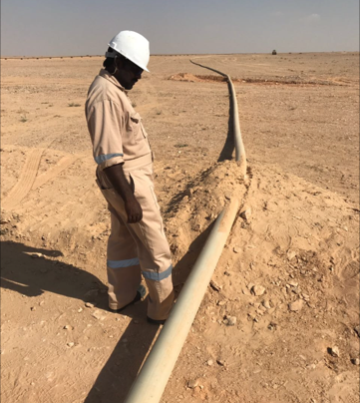
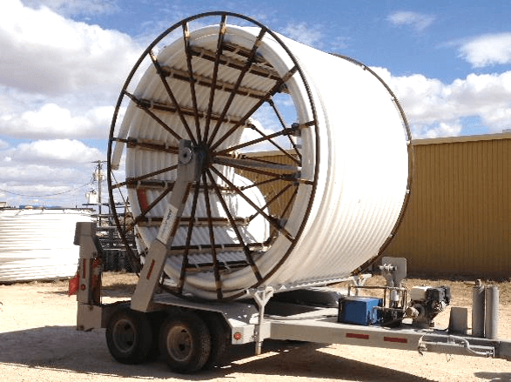
PDO Second Alert
Date:17.01.17 Incident Type: LTI
Photo explaining what was dne wrong
What happened?
While moving the reinforcement frame work piping (RTP) , the pipeline was pulled by a mechanical shovel which resulted in the pipeline hitting a helper resulting in a fracture to his lower right leg.
Your learning from this incident..
Do not stand in the “line of fire”.
Always use the right equipment for the task
Intervene if you see unsafe acts or conditions.
Photo explaining how it should be done right
Always use the right equipment for the task !!!!

Slide 2
Management self audit
Date: 17.01.17 Incident Type: LTI
As a learning from this incident and to ensure continual improvement all contract managers must review their HSE HEMP against the questions asked below
Confirm the following:
Is there a system in place to monitor compliance with PTW system?
Does your HEMP cover all activities ?
Do you ensure your TBT covers all associated hazards for the activity
Is your team empowered to stop unsafe act/condition?
Do you have the right recourses to obtain the task?
Notes:
Make a list of closed questions (only ‘yes’ or ‘no’ as an answer) to ask other contractors if they have the same issues based on the management or HSE-MS failings or shortfalls identified in the investigation. Pretend you have to audit other companies to see if they could have the same issues.

