Slide 1
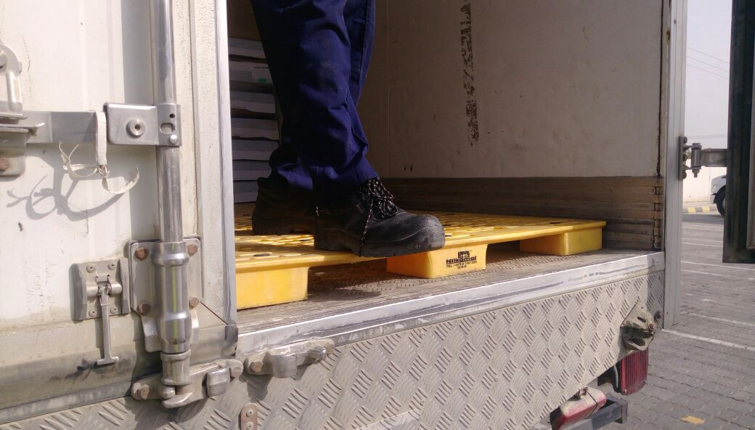
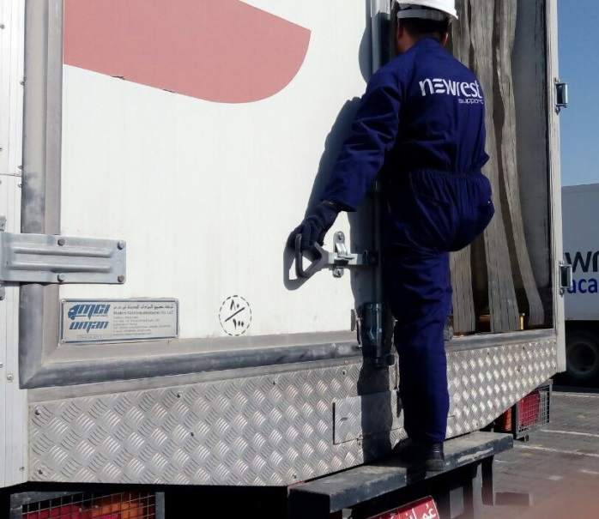
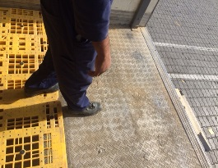
PDO Second Alert
Date: 13.01.17 Incident title: LTI
What happened?
On 13th January 2017, a delivery truck arrived at a Rig camp to deliver food items. The delivery helper climbed the truck and unloaded food items manually. After completion, the helper walked on the pallets towards the door to come down from the truck. While doing so he stepped on the edge of the pallet, tripped and fell from height of 1.5 meter to the ground landing on his left hand resulting in a fractured wrist.
Your learning from this incident..
Ensure adequate supervision for the activity
Ensure that equipment/materials are not causing trip hazards
Ensure you have adequate access / egress to your work area
Ensure you use steps/ladder to access and exit the vehicle
Watch your step!

Slide 2
Management self audit
Date:13.01.17 Incident title: LTI
As a learning from this incident and to ensure continual improvement all contract managers must review their HSE HEMP against the questions asked below
Confirm the following:
Do you supervise catering contractor food delivery activity?
Do you ensure such contractors are monitored and audited?
Do you ensure drivers use steps provided for access / egress of their vehicles?
Notes:
Make a list of closed questions (only ‘yes’ or ‘no’ as an answer) to ask other contractors if they have the same issues based on the management or HSE-MS failings or shortfalls identified in the investigation. Pretend you have to audit other companies to see if they could have the same issues.

