Slide 1
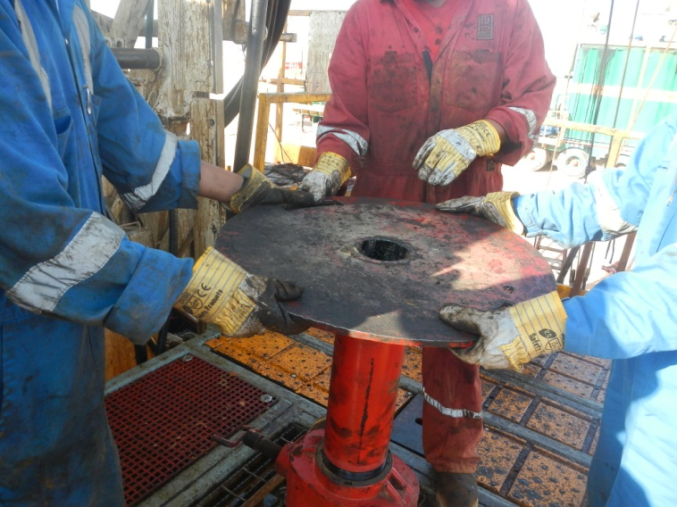

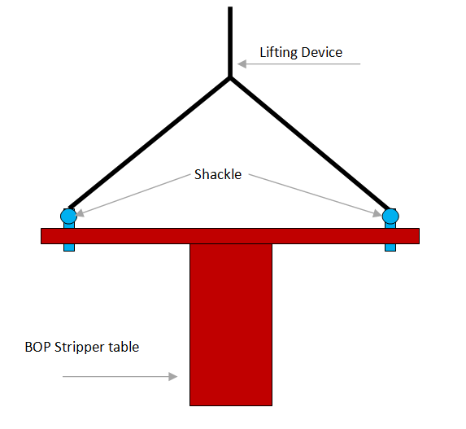

PDO Second Alert
Date: 03.01.17 Incident Type: LTI
What happened?
A floorman, with the help of two colleagues attempted to unscrew and remove the sucker rod (SR) table in order to adjust the SR wiper rubber. As they were removing the table, it slipped from the hands of one worker tilting to one side trapping the floorman’s left hand against one of the stripper screws resulting in a fracture of his left hand little finger.
Learnings from this incident…
Ensure all incidents are reported
Ensure Supervisor’s are supervising
Ensure the task is done using hands off techniques where possible
Mechanical lifting devices should be used when required
Swivel
Use hands-off where possible
1

Slide 2
Management self audit
Date: 03.01.17 Incident Type: LTI
As a learning from this incident and to ensure continual improvement all contract managers must review their HSE HEMP against the questions asked below
Confirm the following:
Did you establish Crew competencies development program?
Do your Supervisors do the supervisory part before they get engaged with the operations?
Have you captured all the hazards in your HEMP?
Are your employees encouraged to stop and assess Dynamic Risks?
2
Notes:
Make a list of closed questions (only ‘yes’ or ‘no’ as an answer) to ask other contractors if they have the same issues based on the management or HSE-MS failings or shortfalls identified in the investigation. Pretend you have to audit other companies to see if they could have the same issues.

