Slide 1
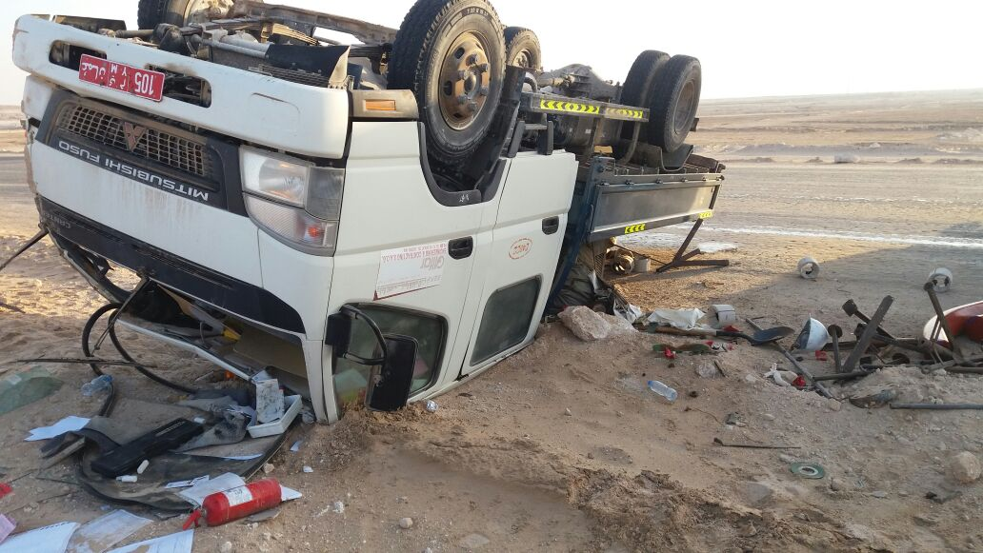
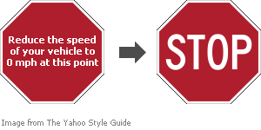
PDO Second Alert
Date:18.01.17 Incident Type : LTI-MVI
What happened?
Canter driver lost control of the vehicle on wet graded road due to speed and over steering .
One passenger suffered an injury to his spine while the driver and another passenger received minor injuries.
Your learning from this incident..
Drive to adjust according to road conditions.
Always be alert and intervene when you notice over speeding by drivers.
Ensure to comply with Signboards & Speed limits.
Seat Belts save lives always wear them.
Always comply with Defensive driving techniques

Slide 2
Management self audit
Date: 18.01.17 Incident Type: MVI-LTI
As a learning from this incident and to ensure continual improvement all contract managers must review their HSE HEMP against the questions asked below
Confirm the following:
Do your drivers apply defensive driving techniques on graded roads ?
Do the supervisors verify from his crew about their driver’s behavior on roads ?
Does the supervisor monitor the IVMS data and discuss with drivers ?
Does the crew discuss among themselves the hazards on route to the location ?
Do the supervisors encourage intervention culture among the workforce ?
Are the workers aware of consequence Management in case of Non compliance to LSR ?
Notes:
Make a list of closed questions (only ‘yes’ or ‘no’ as an answer) to ask other contractors if they have the same issues based on the management or HSE-MS failings or shortfalls identified in the investigation. Pretend you have to audit other companies to see if they could have the same issues.

