Slide 1
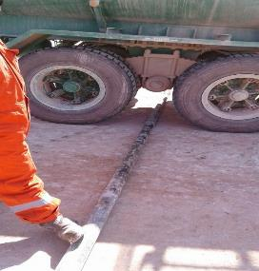
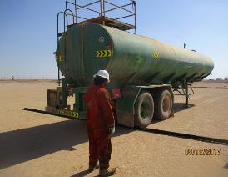
PDO Second Alert
Date: 31.01.17 Incident Type: LTI
What happened?
The Heavy Driver drove over a 3 ½ “ Drill pipe, which was laying between the tyres of the brine water tanker trailer causing the drill pipe to move. The forklift operator, who was standing nearby, saw the pipe moving and tried to secure it with his right foot. His foot got stuck resulting in a broken ankle.
Your learning from this incident..
Keep yourself in a safe position at all times
Ensure equipment is set up safely
If you join an on-going task make sure you know the hazards related to the task
Stay away from equipment that is not secured
Safely remove all items / equipment immediately after the task is done (Housekeeping)
Do not move into the Line of Fire

Slide 2
Management self audit
Date: 31.01.17 Incident Type: LTI
As a learning from this incident and to ensure continual improvement all contract managers must review their HSE HEMP against the questions asked below
Confirm the following:
Do you have clear instructions for a shift handover / rotation handover?
Does the shift handover / rotation handover cover all levels of supervision?
Do you have scheduled daily workplace walkthroughs (Gemba walks)?
Do you ensure that equipment is set up safely and removed when no longer required?
Does your layout plan take temporary pipe connections into consideration, i.e. direct line between well head and pit to be free from obstacles?
Notes:
Make a list of closed questions (only ‘yes’ or ‘no’ as an answer) to ask other contractors if they have the same issues based on the management or HSE-MS failings or shortfalls identified in the investigation. Pretend you have to audit other companies to see if they could have the same issues.

