Slide 1
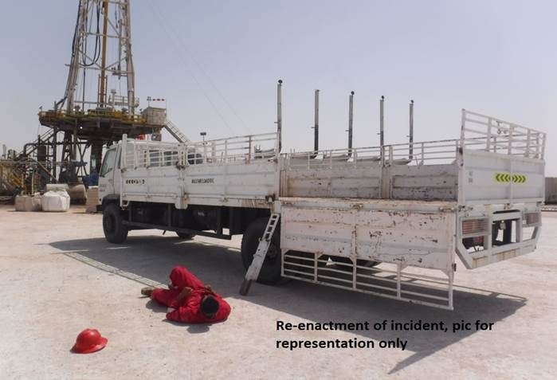
PDO Second Alert
Date: 11.03.2017 Incident type: LTI
What happened?
While a Driver was opening the side panels of his truck, he became dizzy and fell to the ground, where he was found disoriented. He was checked by the medical team and found to have high blood sugar levels (driver had a history of diabetes). During his fall he was hit by the side panel of his truck resulting in a fracture to his left leg.
Your learning from this incident..
Always ensure you are authorised to enter a site before conducting any work
Always report to Site Supervisor first before executing any task
Ensure you attend all medicals and follow up appointments
Ensure you have a valid Fitness to Work certificate
Always inform your supervisor if you are feeling unwell
Photo explaining what was done wrong
Photo explaining how it should be done right
Your health is your responsibility

Slide 2
Management self audit
Date: 11.03.2017 Incident type: LTI
As a learning from this incident and ensure continual improvement all contract
managers must review their HSE HEMP against the questions asked below
Confirm the following:
Do you conduct regular Fitness to Work checks for your personnel as per SP1230?
Do you have a system to ensure Fitness To Work checks are properly followed up?
Do you ensure location access is strictly controlled and all visitors report to site supervisor?
Do you ensure employees with chronic medical conditions are monitored and have a valid FTW?
Notes:
Make a list of closed questions (only ‘yes’ or ‘no’ as an answer) to ask other contractors if they have the same issues based on the management or HSE-MS failings or shortfalls identified in the investigation. Pretend you have to audit other companies to see if they could have the same issues.

