Slide 1
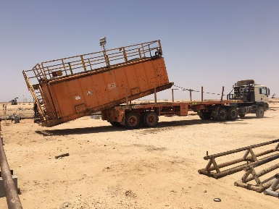
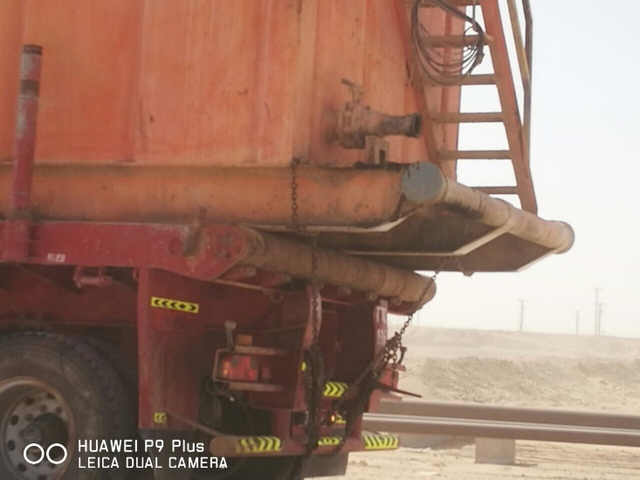
PDO Second Alert
Date: 23.03.2017 Incident type: LTI
What happened?
During the move of the circulation tank from Thuleilat-47 to Rahab-133 on a graded road, the circulation tank came off the flatbed trailer because the driver had not secured the load. The sudden shifting of the load caused an impact onto the flatbed. This impact was transferred to the Prime Mover causing the steering wheel of the Prime Mover to turn suddenly. The spoke of the steering wheel hit the driver’s left hand. The driver was diagnosed with a fracture on the left hand ring finger.
Your learning from this incident…
Ensure loads are secured as per SP 2001 requirements
Ensure supervision is available on each worksite
Ensure vehicle and loads are checked prior to vehicles leaving the worksite
Ensure loads are secured as per SP 2001 Factsheets

Slide 2
Management self audit
Date: 23.03.2017 Incident type: LTI
As a learning from this incident and ensure continual improvement all contract
managers must review their HSE HEMP against the questions asked below
Confirm the following:
Do you have defined / allocated supervision for each worksite?
Have you formally trained all your Heavy Drivers on Load Securing?
Have you executed a Load Security competency assessment on your drivers?
Do you have formalized load / vehicle checks before a vehicle is leaving any worksite?
Notes:
Make a list of closed questions (only ‘yes’ or ‘no’ as an answer) to ask other contractors if they have the same issues based on the management or HSE-MS failings or shortfalls identified in the investigation. Pretend you have to audit other companies to see if they could have the same issues.

