Slide 1
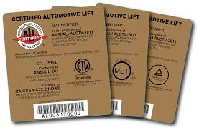
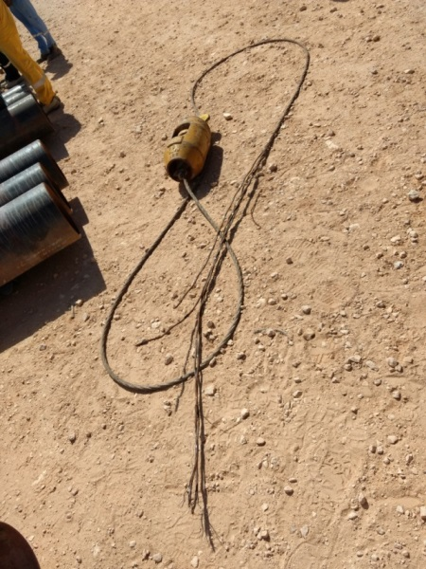
PDO Second Alert
Date: 28/1/2017 @ 10.20 am, WPAI pipe storage yard, Nimr- IMC
Description of the incident
During offloading the 12” pipe from a trailer with a 25T crane, an auxiliary hook
Rope failed. It happened when two pipes were lifted from the trailer to make
Space for inserting wooden planks. The auxiliary hook wire rope snapped and
the hook fell down missing the nearest banksman.
Your learnings from this incident
Always ensure lifting equipment and attachments have a valid 3rd party certification.
Always ensure the crane operators conduct a pre-work check.
Always ensure compulsory safety checks are conducted when lifting equipment arrives at site.
Always ensure you have a lifting plan in place.
Ensure staff and supervisors are trained and understand their responsibilities.
Use only certified lifting equipment in good condition

Slide 2
Management self audit
Date: 28 January 2017 High Potential Near Miss in Nimr (Lifting)
As a learning from this incident and ensure continual improvement all contract
managers must review their HSE HEMP against the questions asked below
Confirm the following:
Do you ensure your teams follow safe lifting practices?
Do you have an effective equipment inspection protocol for all lifting equipment?
Do you ensure your supervisors are competent in lifting operations and aware of their responsibilities?
Do you ensure all crane operators are trained and certified?
Do you ensure adequate checks are carried out on equipment condition and 3rd party certificates before bringing cranes to the site?
Notes:
Make a list of closed questions (only ‘yes’ or ‘no’ as an answer) to ask other contractors if they have the same issues based on the management or HSE-MS failings or shortfalls identified in the investigation. Pretend you have to audit other companies to see if they could have the same issues.

