Slide 1
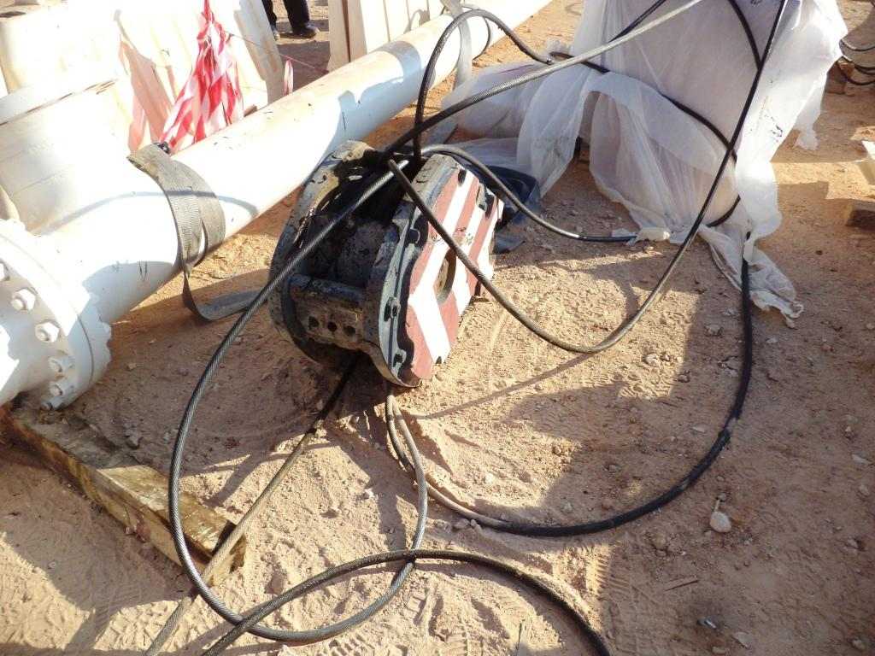
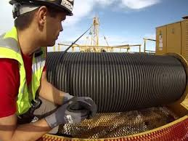
PDO Second Alert
Date:16.02.2017
What happened?
While shifting & lowering the 14 M long x 12” pipe spool to the ground using a 110T Mobile crane, the crane hook fell down from 3.0 M height due to unwinding of entire wire rope from the rope drum when the load was just 10 cm above ground.
Your learning from this incident..
Ensure all warning & protective devices are checked by the Crane Operator & Maintenance Supervisor as per the manufacturers recommendations.
Ensure all faults observed by Operator on his daily inspection are reported to the Supervisor immediately.
HiPo Near Miss - Crane hook & wire rope fell on to the ground
Verify critical devices during crane inspection

Slide 2
Management actions
Date: 16.02.2017 HiPo Near Miss - Crane hook & wire rope fell on to the ground
As a learning from this incident and ensure continual improvement all contract
managers are to review their HSE HEMP against the questions asked below
Confirm the following:
Do you have a lifting procedure in place?
Is there a system in place to monitor compliance with the lifting procedure?
Are all lifting activities properly planned & organized?
Are all those involved in lifting activity are trained & competent?
Is lifting activity included in the HEMP?
Do you monitor the sub-contractor maintenance records & repair log?
Do you verify the Crane inspection checklist from the supplier at the time of deployment to site?

