Slide 1
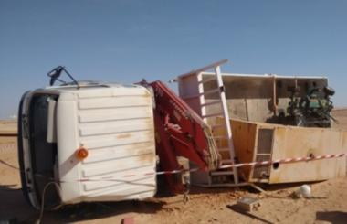
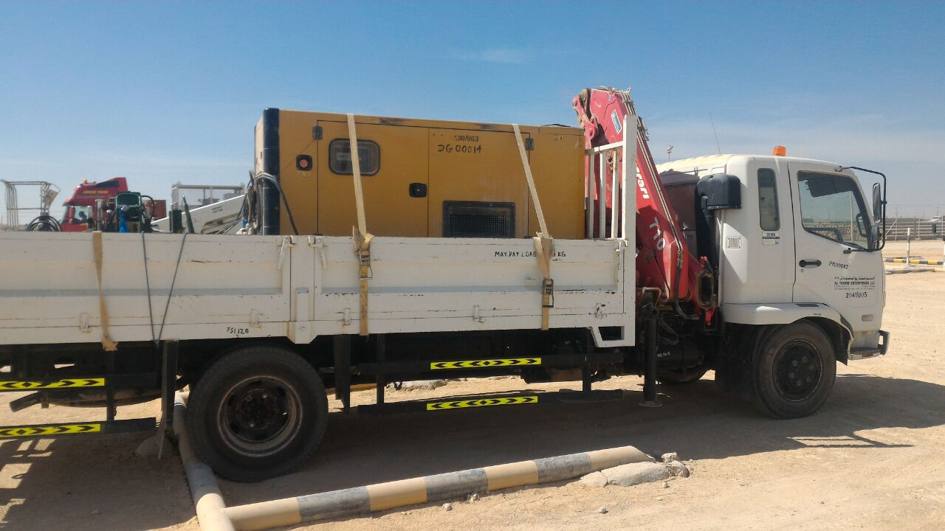
PDO Second Alert
Date: 24.03.2017 Incident: MVI-MTC
What happened?
HIAB loaded with a diesel generator and fusion machine tipped over to the left side while making a right turn on graded road, resulting in minor injury to the driver and damage to the vehicle.
Your learning from this incident..
Drivers :
Negotiate bends at appropriate speed.
Respect intervention
All Personnel :
Use only authorised routes.
Use padding for improved load restraint
Always Drive the vehicle according to the road condition

Slide 2
Management self audit
Date: 24.03.2017 Incident: MVI-MTC
As a learning from this incident and ensure continual improvement all contract
managers must review their HSE HEMP against the questions asked below
Confirm the following:
Do you ensure that Journey plan route is followed ?
Do you ensure that new/young drivers are adequately mentored prior to assigning the task?
Is there any arrangement to communicate from GSM blind/remote area?
Is there any assurance system to ensure load is adequately restrained?
Do have a formal system to monitor the driver’s behaviour other than IVMS?
Notes:
Make a list of closed questions (only ‘yes’ or ‘no’ as an answer) to ask other contractors if they have the same issues based on the management or HSE-MS failings or shortfalls identified in the investigation. Pretend you have to audit other companies to see if they could have the same issues.

