Slide 1
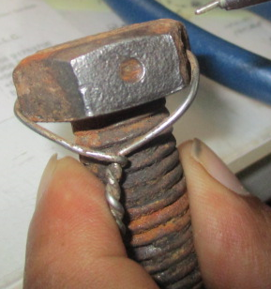
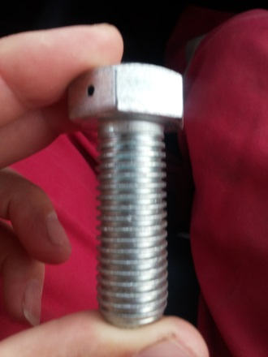
PDO Second Alert
HIPO Near Miss, 24th Mar 2017
What happened?
While drilling 8½” hole section, the Derrickman observed that the stabber guide was hanging by its secondary retention. The Driller was informed and the operation was stopped immediately. A safety meeting was conducted with site supervisors and crew members to discuss required action to rectify the situation, Drill pipe stand was racked back and TDS was descended to the rig floor so the stabber guide could be reattached.
Your learning from this incident..
Secondary retention worked effectively preventing a DROPs incident
Learning from an previous incident was utilized and implemented preventing a DROPs incident
Incorrect bolts were installed as means of primary retention for the stabber guide bracket
Bolt length and threads weren't inspected prior to reinstallation
Lock wire on the bolts wasn’t installed correctly
Incorrect length bolt and worn threads
Always ensure the correct grade and length bolts are used
Correct length bolt and good threads

Slide 2
Management self audit
HIPO NM, 24th Mar 2017
As a learning from this incident and ensure continual improvement all contract
managers must review their HSE HEMP against the questions asked below
Confirm the following:
Does your DROPs inspection include checking both primary and secondary retention?
Does your Snr mechanic complete a DROPS inspection on the TDS at regular intervals?
Do you have a quality assurance procedure for checking 3rd party DROPS inspections?
Notes:
Make a list of closed questions (only ‘yes’ or ‘no’ as an answer) to ask other contractors if they have the same issues based on the management or HSE-MS failings or shortfalls identified in the investigation. Pretend you have to audit other companies to see if they could have the same issues.

