Slide 1
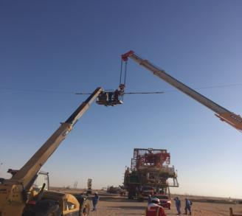
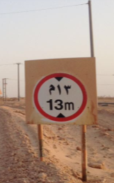
PDO Second Alert
Date: 24/25.03.2017 Incident title: Near Miss / Unsafe Act
What happened?
During a recent Rig Move, several Kicker board lines were lifted by Crane, telehandler (man riding basket) and person climbing on monkey board to lift Kicker board line clear of the Rig Mast. Empowerment to Stop the Work was invoked.
Your learning from this incident..
Follow through empowerment to stop
Follow written procedures
Comply with the Route Survey
Consult Electrical department when lines are too low
Notify Electrical department when lines are too low
Route Survey
Obstructions, Pipelines, OHL, KB, Sharp junctions, Gradients etc
PLAN AND DOCUMENT CHANGES TO THE OPERATION

Slide 2
Management self audit
Date: 24/25.03.2017 Incident title: Near Miss / Unsafe Act
As a learning from this incident and ensure continual improvement all contract
managers must review their HSE HEMP against the questions asked below
Confirm the following:
Do you ensure the DSV or Tool Pusher are present during Route Surveys?
Do you ensure all OHL’s are measured and recorded on the Route Survey?
Do you ensure the height of the rig is confirmed during the Pre Rig Move Meetings?
Do you ensure all personnel are aware of the Empowerment to Stop the Work?
Do you utilise the Management of Change (MOC) process for changes to the operation?
Notes:
Make a list of closed questions (only ‘yes’ or ‘no’ as an answer) to ask other contractors if they have the same issues based on the management or HSE-MS failings or shortfalls identified in the investigation. Pretend you have to audit other companies to see if they could have the same issues.

