Slide 1
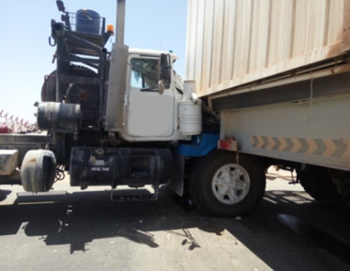
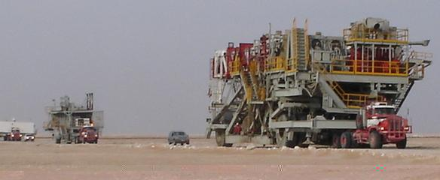
PDO Second Alert
Date: 03 April 2017 Incident title: Rig 32 MVI
What happened?
On 03rd April 2017, at 10:49 am, a Motor Vehicle Incident occurred during a rig move convoy. The vehicles were halted before a section of road with barriers. This caused the vehicles to close up towards each other. A vehicle in the convoy was preparing to move off through the obstruction, when a vehicle behind collided into the rear of the vehicle. Fortunately the driver only sustained a small abrasion to his forehead which was treated at Shaleem Medical Clinic. He was treated then released to return to work.
Your learning from this incident..
Maintain the correct convoy distance
Always ensure you conduct your daily vehicle checks and report faults
Always conduct a brake function test before setting off on journeys
Ensure you conduct a walk round inspection of rig trailers
STOP if you think something isn’t right or you notice a safety hazard.
Keep a safe distance

Slide 2
Management self audit
Date: 03 April 2017 Incident title: Rig 32 MVI
As a learning from this incident and ensure continual improvement all contract
managers must review their HSE HEMP against the questions asked below
Confirm the following:
Have Risk Assessments been updated / reviewed after the last incident within your company?
Have Senior Management conducted any integrity checks on vehicle maintenance?
Do operations validate the completion of vehicle daily inspections on a regular basis?
Has a management review of TBT discussing convoy and rig move procedures been completed?
Notes:
Make a list of closed questions (only ‘yes’ or ‘no’ as an answer) to ask other contractors if they have the same issues based on the management or HSE-MS failings or shortfalls identified in the investigation. Pretend you have to audit other companies to see if they could have the same issues.

