Slide 1
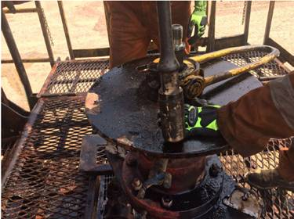
PDO Incident First Alert
Incident type | LTI (#36)
Date/ time | 19.09.17 at 05:20 hrs | Directorate
Location | Hoist 01 - Marmul | Dept
What happened
The floorman was guiding the Sucker Rod (SR) to align it to the connection by pulling it with his right hand while putting his left hand on the SR table for support , the SR slipped crushing his left hand resulting in fractured finger.
Mr. Musleh asks the questions of can it happen to you?
Do you ensure you keep your hands away of the line of fire?
Do you ensure you are handling the tubulars correctly ?
Do you ensure a clear communication with your team members?
Crush point
Please disseminate this LTI notification to your teams and use it in your tool box talks and HSE meetings and notice boards.

