Slide 1
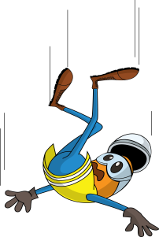
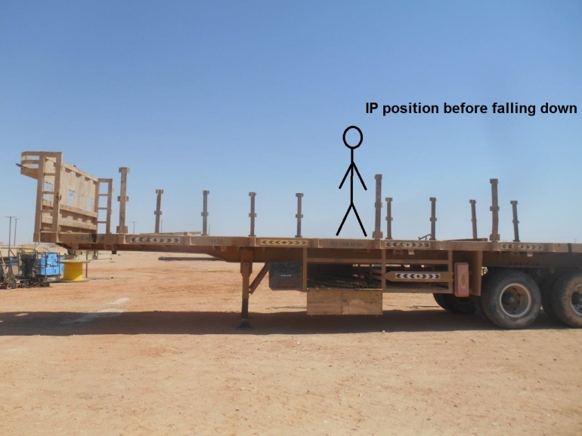
PDO Incident First Alert
Incident type | LTI (#37)
Date/ time | 26.09.17 at 09:50 hrs | Directorate
Location | Hoist 103 - Nimr | Dept
What happened
The driver was preparing the trailer to load the tubing by putting wooden dunnage on the top. While doing so, he lost his balance and fall to the ground landing on his left hand fracturing his forearm.
Mr. Musleh asks the questions of can it happen to you?
Do you use a working platform when working at height?
Do you always consider how you can fall from height?
Do you check if you can do the task from the ground?
Please disseminate this LTI notification to your teams and use it in your tool box talks and HSE meetings and notice boards.

