Slide 1
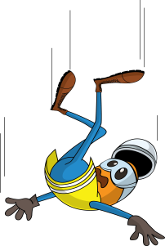
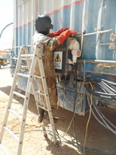
PDO Incident First Alert
Incident type | LTI (#38)
Date/ time | 05.03.17 at 13:30 hrs | Directorate
Location | Hoist 122 - Rima | Dept
What happened
The welder was using a ladder to climb up on the manager’s caravan to install a shade for the electrical distribution board when he lost his balance and fell to the ground landing on his right hand fracturing his right wrist.
Mr. Musleh asks the questions of can it happen to you?
Do you ensure the ladder is appropriate for safe access?
Do you ensure the ladder is secure or someone is footing the ladder before climbing?
Do you ensure you have 3 points of contact at all times?
Please disseminate this LTI notification to your teams and use it in your tool box talks and HSE meetings and notice boards.

