Slide 1
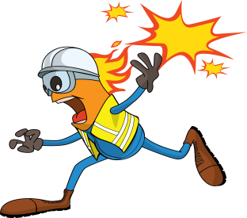
PDO Incident First Alert - PDO
Incident type | LTI (#39)
Date/ time | 25.09.17 at 11:00hrs | Directorate
Location | Lekhwair L-398 | Dept
What happened
A mechanical crew was working on the flowline from L398 to replace a valve near Lekhwair B station, when a flash fire occurred at the drain point injuring a crew member resulting in burns to both hands.
Mr. Musleh asks the questions of can it happen to you?
Do you ensure the pipeline is appropriately earthed?
Do you ensure you are using the right PPE for the task?
Do you ensure crew members are in a safe location?
Drain point where flash fire occurred
Please disseminate this LTI notification to your teams and use it in your tool box talks and HSE meetings and notice boards.

