Slide 1
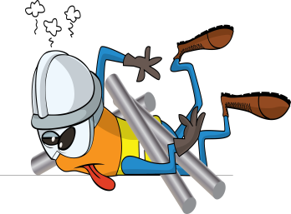
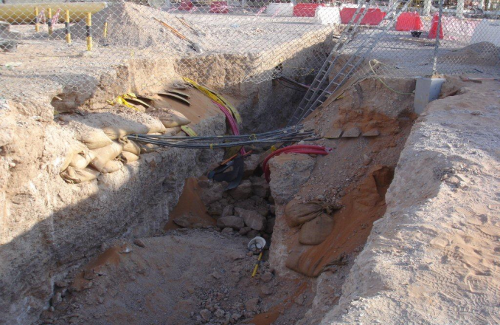
PDO Incident First Alert
Incident type | LTI (#40)
Date/ time | 30.09.17 at 13:35hrs | Directorate
Location | Lekhwair | Dept
What happened
While a civil crew was working inside a 3 metre deep excavation, the wall of the trench collapsed partially burying a helper, resulting in a fracture of his pelvis.
Mr. Musleh asks the questions of can it happen to you?
Do you ensure the trench sides are secured before entering an excavation?
Do you ensure all hazards are identified before performing the task?
Do you ensure adequate controls are in place?
Trench walls collapsed
Please disseminate this LTI notification to your teams and use it in your tool box talks and HSE meetings and notice boards.

