Slide 1
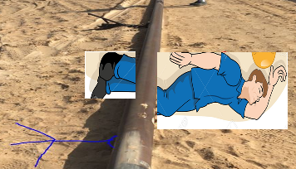
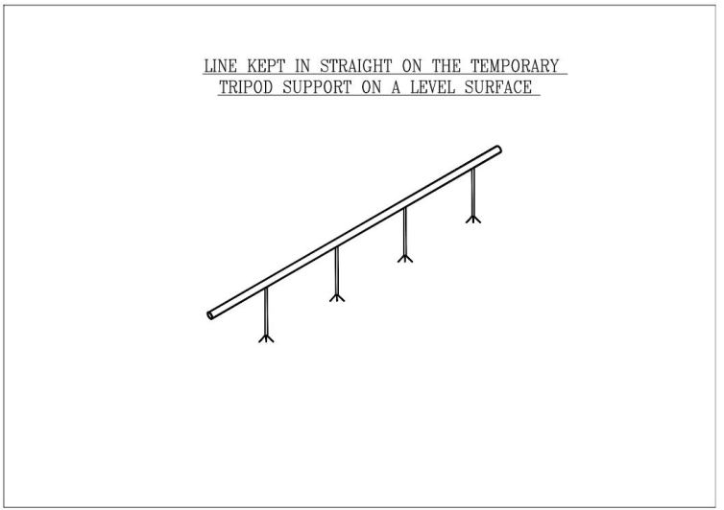

PDO Second Alert
Date:02.04.2017 Incident type: LTI
What happened?
The flowline pipe was rested on the tripod and due to the stress relief the pipeline straightened and fallen on the permit holders legs as he was walking parallel to the line which resulted in fracture to his right leg.
Your learning from this incident..
Always ensure you stay at safe distance from line.
Ensure safe positioning of supporting stands prior to starting of work and monitor .
Ensure that the hazards & risk involved in the activities are discussed and controls are in place with all involved staffs
Intervene when you see unsafe act or conditions
Check your position and stay away from the “Line of Fire “

Slide 2
Management self audit
Date: 02.04.2017 Incident type: LTI
As a learning from this incident and to ensure continual improvement all contract managers must review their HSE HEMP against the questions asked below:
Confirm the following:
Do you ensure the crew knows about the hazards involved in the work?
Do the supervisors continuously monitor the site activities?
Do you ensure competence of workforce deployed to the job?
Do you encourage intervention culture amongst your workforce ?
Do you consider complacency as a risk factor for your workforce doing routine activities ?
Notes:
Make a list of closed questions (only ‘yes’ or ‘no’ as an answer) to ask other contractors if they have the same issues based on the management or HSE-MS failings or shortfalls identified in the investigation. Pretend you have to audit other companies to see if they could have the same issues.

