Slide 1
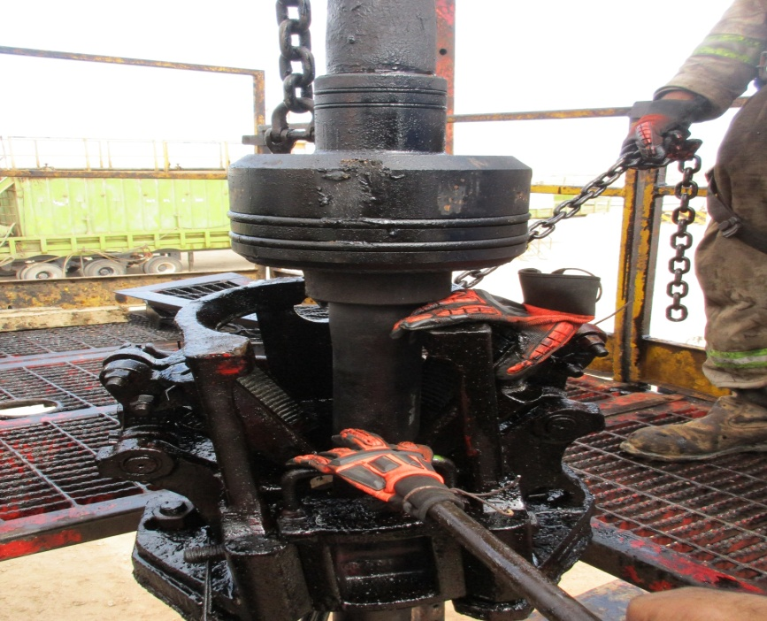
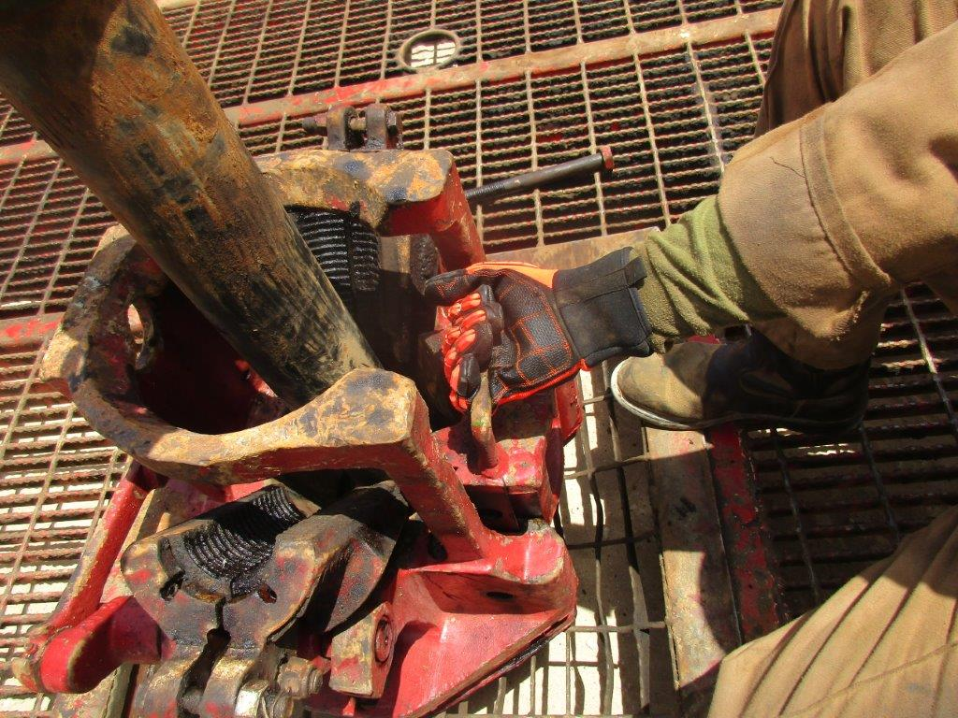
PDO Second Alert
Date: 29.04.17 Incident Type: LTI
What happened?
During running in the hole 11" tubing hanger, a Floorman was removing the slip's door, when the traveling block moved, pinching the Floorman's right hand between the top of the slips and the tubing hanger.
Your learning from this incident.
Always use the handles provided when handling the slips
Ensure you keep your hands away of pinch points
Always follow the set procedures for the job
Photo to be provided
Never put your Hands in line of fire

Slide 2
Management self audit
Date: 29.04.17 Incident Type: LTI
As a learning from this incident and ensure continual improvement all contract
managers must review their HSE HEMP against the questions asked below
Confirm the following:
Does your HEMP cover all activities?
Do you ensure your TBT covers all associated hazards for the activity
Is your team empowered to stop any unsafe act /condition?
Do you ensure all unsafe acts / conditions are reported and closed out?
Do you ensure staff are complying with the internal company’s policies and procedure?
Notes:
Make a list of closed questions (only ‘yes’ or ‘no’ as an answer) to ask other contractors if they have the same issues based on the management or HSE-MS failings or shortfalls identified in the investigation. Pretend you have to audit other companies to see if they could have the same issues.

