Slide 1
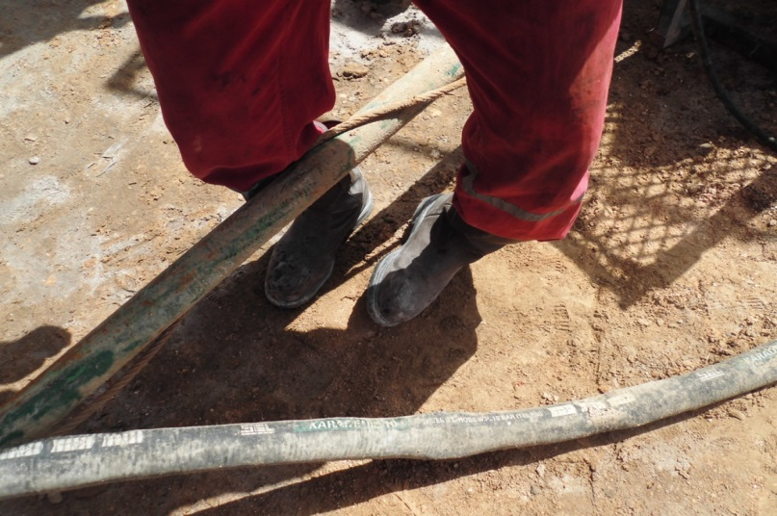
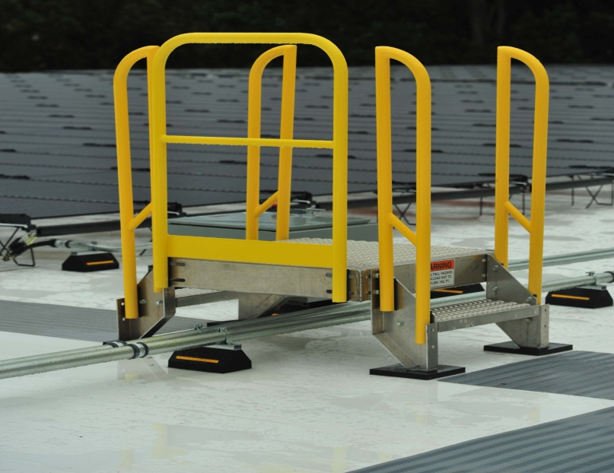
PDO Second Alert
Date: 24.04.2017 Incident title :LTI
What happened?
On 24th April 2017 at 16.00, operation was RIH 3 ½” cement stinger. Inside cellar there was water needed to be withdrawn. After laying cellar pump’s suction hose into the cellar, Derrick man (IP) stepped onto the ground with his left foot, crossing over a kill line (30 cm above the ground level). He was referred to PDO clinic in Yibal and subsequently to Ibri hospital . He was diagnosed with a fracture on left foot.
Your learning from this incident..
While moving through a well site location, always be focused and watch where do you step.
Ensure to have good house keeping around your working area.
Avoid taking shortcut.
Prevent crossing lines above ground level and introduce dedicate steps across lines.
Always be vigilant while moving across well site location

Slide 2
Management self audit
Date: 24.04.2017 Incident title :LTI
As a learning from this incident and to ensure continual improvement all contract managers must review their HSE HEMP against the questions asked below:
Confirm the following:
Do you ensure learnings from previous incidents are properly disseminated to all work force?
Does your crew discuss the potential hazards of routine activities?
Do you make sure previous injuries undergo a FTW before resuming work again?
How do you manage the risks of slip ,trips, & fall hazards (Risk Normalization)?
Notes:
Make a list of closed questions (only ‘yes’ or ‘no’ as an answer) to ask other contractors if they have the same issues based on the management or HSE-MS failings or shortfalls identified in the investigation. Pretend you have to audit other companies to see if they could have the same issues.

