Slide 1
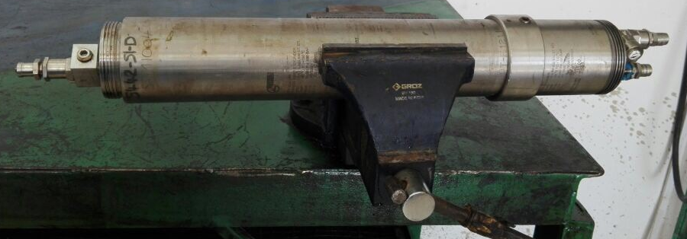
PDO Second Alert
Date: 03.01. 2017 Incident type: LTI
What happened?
A sampling Engineer was working alone at workshop at evening conducting disposal of charged sampling bottle [cylinder that contained pressurized oil sample]. He left the sample plug unopened and opened the 3 valves leaving the pressurized fluid inside when he commenced dismantling the cylinder. He then hammered the piston when suddenly it blew out of the cylinder striking the Engineer in both of his hands and smashing some glass in the workshop. The incident caused a fracture to his right hand index finger and left wrist.
Your learning from this incident..
When dealing with risky tools, never take short-cuts and if you are not sure how safe the tool is, STOP the job.
Ensure team aware of existing procedures that are supposed to protect them.
Valve closed
Valves open
Valve open
Valves open
Never take shortcuts, if in doubt, STOP and check!

Slide 2
Management self audit
Date: 03.01. 2017 Incident type: LTI
As a learning from this incident and to ensure continual improvement all contract managers must review their HSE HEMP against the questions asked below:
Confirm the following:
Do you ensure all procedures are up to date and staff have read and understood them?
Do you ensure your risk register / HEMP are up to date and staff are updated and aware of any changes?
Do you ensure you have adequate competent HSE representation in your business?
Notes:
Make a list of closed questions (only ‘yes’ or ‘no’ as an answer) to ask other contractors if they have the same issues based on the management or HSE-MS failings or shortfalls identified in the investigation. Pretend you have to audit other companies to see if they could have the same issues.

