Slide 1
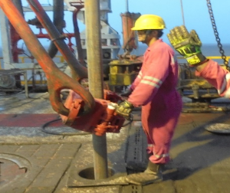
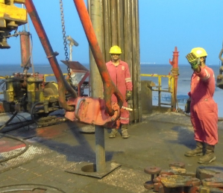
PDO Second Alert
Date: 03.05.2017 Incident Type: LTI
What happened?
While picking up 4 ½” liner from catwalk to the mouse hole using driller side air winch. The Floorman was having difficulties in latching the elevator to the liner in the mouse hole. While his hands were still holding the handles of the elevator, he gave a verbal signal to the Driller to operate the link tilt backwards slightly. When the bails tilted back, the elevator moved downwards and struck the Floorman' s finger resulting in a crush injury to his right hand middle finger.
Your learning from this incident..
Always ensure the TRIC and the JSP for the task, capture all the hazards/ risks & controls related to dynamic pinch points.
Encourage all personnel to utilize effective intervention while performing the task.
Always stay away from the line of fire while giving signals to the Driller.
Promote use of learning from CCTV footage
Floorman holding elevator handles when he gave signal to tilt the bails
Stay clear when the bails are in motion
Stay away when the bails are in motion

Slide 2
Management self audit
Date: 03.05.2017 Incident Type: LTI
As a learning from this incident and ensure continual improvement all contract
managers must review their HSE HEMP against the questions asked below
Confirm the following:
Does your JSP s capture all the hazards?
Does your crew intervene when ever an unsafe act/condition occurs?
Do you periodically review your HEMP?
Do you have a pinch point register and is it reviewed periodically?
Is there an assurance program for conducting assessment of the LOD process?
Is there a process to utilize and report use of CCTV footage in identifying “safe” and “at risk” behaviors in daily operations?
Notes:
Make a list of closed questions (only ‘yes’ or ‘no’ as an answer) to ask other contractors if they have the same issues based on the management or HSE-MS failings or shortfalls identified in the investigation. Pretend you have to audit other companies to see if they could have the same issues.

