Slide 1
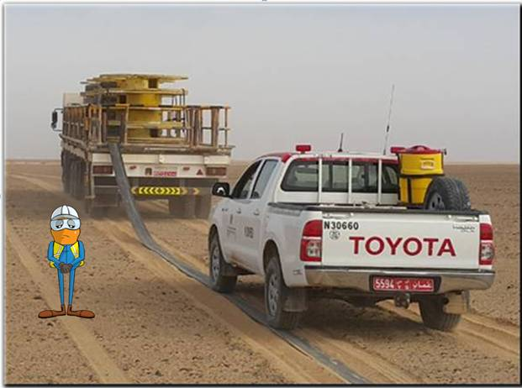
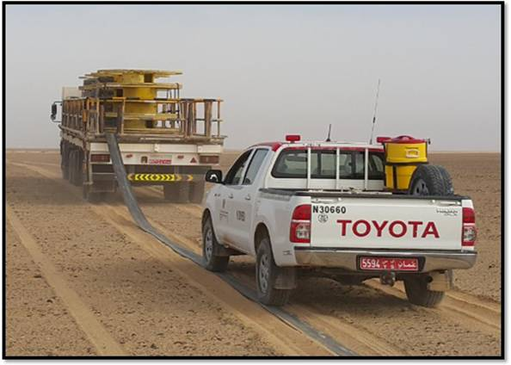
PDO Second Alert
Date: 10.05.17 Incident title: LTI
What happened?
On 10th May at around 11:00 hrs HDU crew started laying hoses at Ufuq using 40 Ton trailer. In the process the trailer slightly turned left following a pre-determined surveyed mark (flag) and the hose slipped from under the wheels of the pickup and hit the Maintenance Technician on his knees resulting in him losing his balance and falling on his right hand resulting in fracture.
Your learning from this incident..
Always ensure good communication between workers
Always consider sources of stored energy
Ensure you are away from the line of fire
Ensure all tasks are covered in your procedures and risk assessments
Direction of hose hitting worker
Keep away from the line of fire

Slide 2
Management self audit
Date: 10.05.17 Incident title : LTI
As a learning from this incident and ensure continual improvement all contract
managers must review their HSE HEMP against the questions asked below
Confirm the following:
Does your HEMP identify all hazards including routine tasks?
Do you conduct work observations to identify potential hazards?
Do you discuss the potential hazards of routine activities with your employees?
Does your supervisors intervene in unsafe acts
Notes:
Make a list of closed questions (only ‘yes’ or ‘no’ as an answer) to ask other contractors if they have the same issues based on the management or HSE-MS failings or shortfalls identified in the investigation. Pretend you have to audit other companies to see if they could have the same issues.

