Slide 1
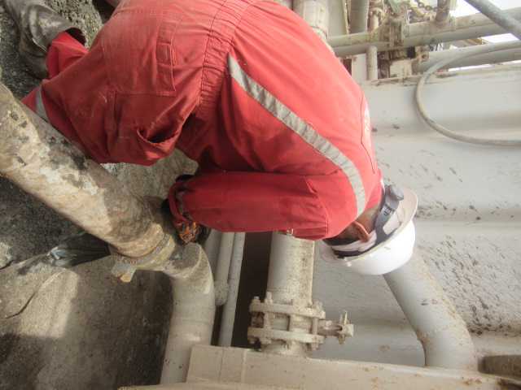
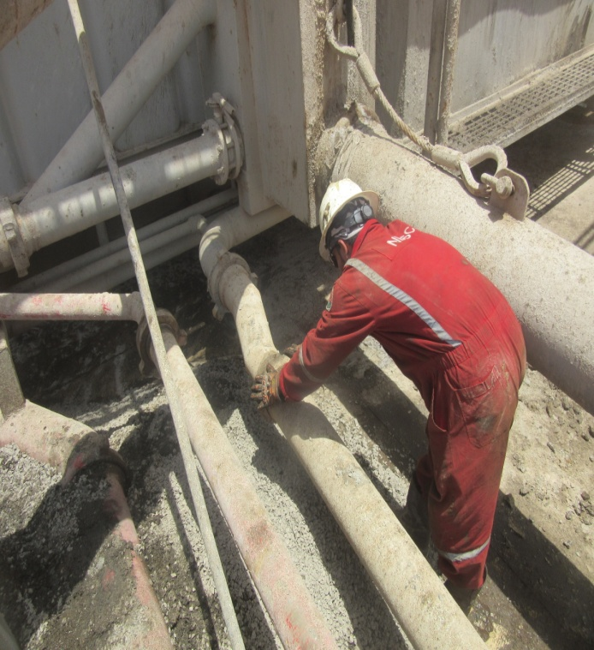
PDO Second Alert
Date: 15.05.17 LTI
What happened?
Operation was general rig up in new location. 6” cutting shoot pipe (12m long) was resting on forklift to be connected with cuttings box (60 cm height from ground) where roustabout started hand tightening hammer union connection. While doing so, roustabout encountered difficulties to connect the line and started to push the pipe by his thigh causing the pipe to swing in horizontal direction towards the cutting box (sharp edge) that was 35 cm away from the connection point. The movement of the pipe crushed the roustabout’s right hand index finger between hammer union and cuttings box. Incident resulted in right index finger tip pulp amputation with bone exposed
Your learning from this incident..
Always ensure you keep your hands away from line of fire.
Seek support from supervisor if you are in doubt.
Ensure adequate communication between workforces
Pushing line while tightening hammer union
Keep hands out of the line of fire
Tightening hammer union without applying force

Slide 2
Management self audit
Date: 15.05.17 Incident title LTI
As a learning from this incident and ensure continual improvement all contract
managers must review their HSE HEMP against the questions asked below
Confirm the following:
Do you ensure all employees know associated hazards with their task performed?
Do you ensure all hazards are captured in your HEMP and communicated/understood by the work force?
Do you ensure equipment is secured to prevent unexpected movement?
Do you have good communication between your crewmembers ?
Notes:
Make a list of closed questions (only ‘yes’ or ‘no’ as an answer) to ask other contractors if they have the same issues based on the management or HSE-MS failings or shortfalls identified in the investigation. Pretend you have to audit other companies to see if they could have the same issues.

