Slide 1
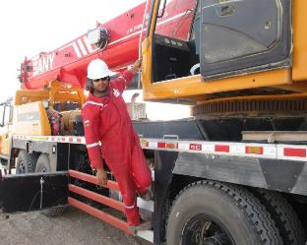
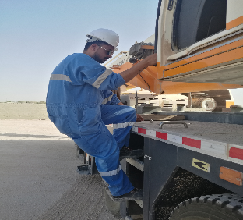
PDO Second Alert
Date: 21.05.2017 Incident type: LTI
What happened?
Crane Operator (CO), after positioning the crane in the jack, climbed on the ladder to access the boom operating cabin. CO stepped on the carrier @ 1.6 m and while attempting to enter the boom operating Cabin, and at the point of changing his hand grip between outside handhold rail to inside cabin handholding point, lost his balance and fell to the ground landing face down. Hospital report confirmed fracture of lower end of radius (right hand) & fracture of 2nd cervical vertebra
Your learning from this incident..
Concentrate on simple and repetitive tasks all times.
Maintain 3 point contact when climbing up /down the ladder.
Pay attention to your footing always.
3
2
1
Maintain 3 point contact when you climb Ladder

Slide 2
Management self audit
Date: 21.05.2017 Incident type: LTI
As a learning from this incident and ensure continual improvement all contract
managers must review their HSE HEMP against the questions asked below
Confirm the following:
Do you perform mobilization check to verify HSEMS arrangements in line with the contracts including on-call contracts ?
Do you Assure Fitness to Work compliance for all your sub contractor & on-call contractors?
Does your crane have access ladder that confirms with EN13000or equivalent requirements?
Are the Crane ladder design adequate for safe access for operator?
Notes:
Make a list of closed questions (only ‘yes’ or ‘no’ as an answer) to ask other contractors if they have the same issues based on the management or HSE-MS failings or shortfalls identified in the investigation. Pretend you have to audit other companies to see if they could have the same issues.

