Slide 1
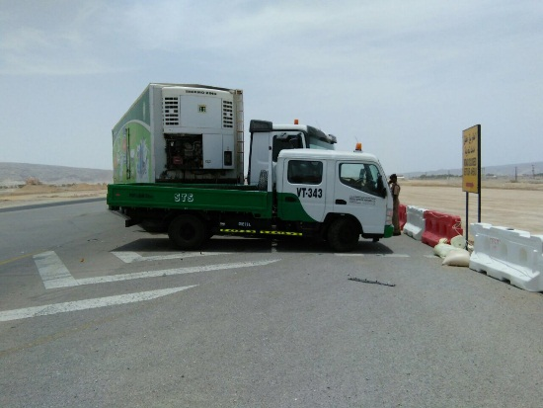

PDO Second Alert
Date: 05.06.2017 Incident: LTI MVI
What happened?
Canter driver was making a “U” turn to reach a shop on the side of the road when a third party truck collided with the side of the Canter resulting in a fracture injury to left shoulder blade of the Canter driver and damaged both vehicles.
Your learning from this incident.
Always stay alert while driving, and observe other drivers behaviour
Always follow defensive driving techniques
Always ensure you follow road signage and local road traffic laws
Always stay alert while driving, and observe other drivers behaviour

Slide 2
Management self audit
Date: 05.06.2017 Incident: LTI MVI
As a learning from this incident and ensure continual improvement all contract
managers must review their HSE HEMP against the questions asked below
Confirm the following:
Do your drivers follow defensive driving techniques ?
Do you ensure that driver behaviour is monitored and any issues discussed and recorded?
Do you have effective Road Safety campaigns?
Do you have forum for drivers to discuss Road Safety related topics?
Notes:
Make a list of closed questions (only ‘yes’ or ‘no’ as an answer) to ask other contractors if they have the same issues based on the management or HSE-MS failings or shortfalls identified in the investigation. Pretend you have to audit other companies to see if they could have the same issues.

