Slide 1
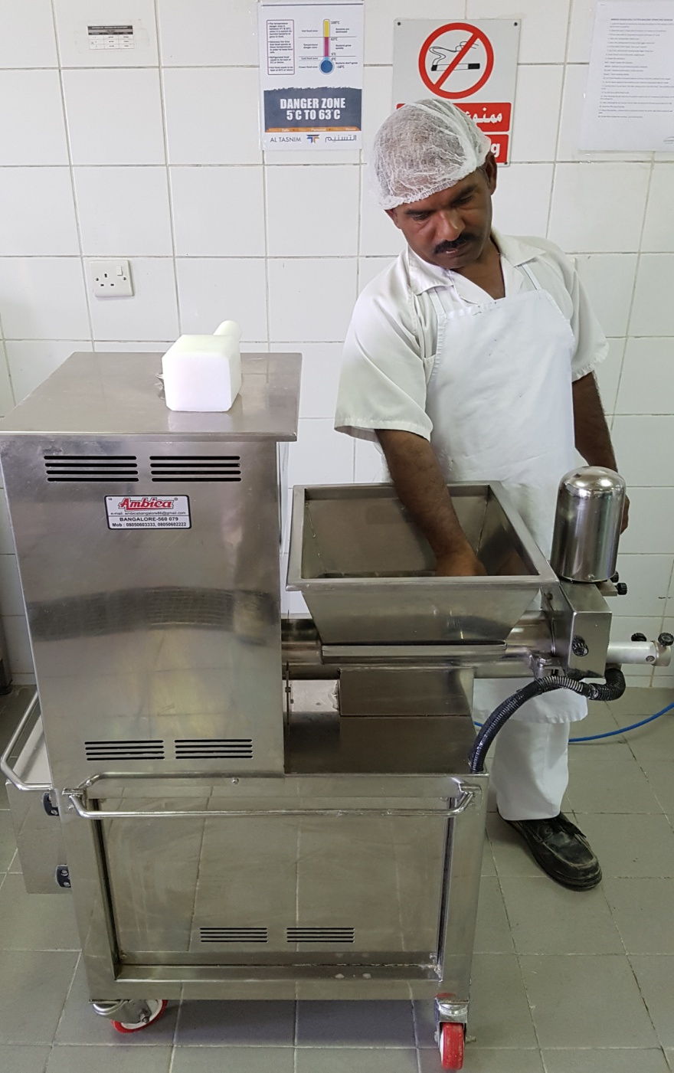

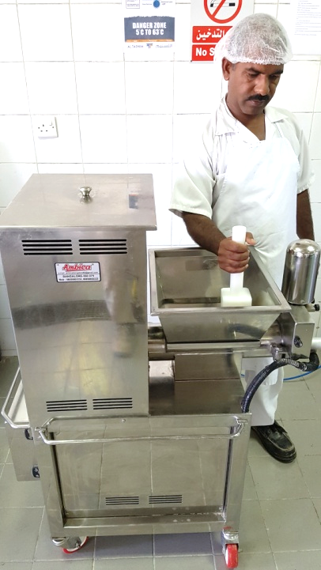
PDO Second Alert
Date: 13.06.2017 Incident: LTI
What happened?
A Cook and his helper were preparing dough-ball for chapatti with dough divider machine. Towards the end of the operation, the cook found that some gluten was stuck inside the hopper and pushed it down with his bare hand. Two of the cooks fingers slipped into the rotating screw shaft; amputating his right hand thumb and index fingers.
Your learning from this incident..
Always use the right tool for operations.
Always keep the moving parts of a machine properly guarded.
Always ensure safety guards are installed with interlock system
Do you consider what can go wrong?
Cook put his bare hand without switching off the machine
Always ensure the right tools are used for the task
After switching off the machine use of right tool to push the gluten

Slide 2
Management self audit
Date: 13.06.2017 Incident: LTI
As a learning from this incident and ensure continual improvement all contract
managers must review their HSE HEMP against the questions asked below
Confirm the following:
Do you have a system to ensure that the machine guards and covers are always in place during operation?
Do you have a system to ensure that the employees are adequately trained for the assigned job?
Do you have a system to conduct daily toolbox talks before commencing the work?
Do you make the team aware about the recovery process in case of an emergency ?
Notes:
Make a list of closed questions (only ‘yes’ or ‘no’ as an answer) to ask other contractors if they have the same issues based on the management or HSE-MS failings or shortfalls identified in the investigation. Pretend you have to audit other companies to see if they could have the same issues.

