Slide 1
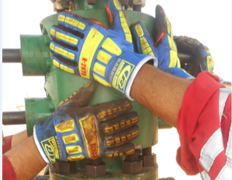
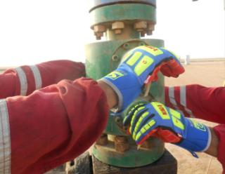
PDO Second Alert
Date: 15.06.2017 Incident: LTI
What happened?
A BOP was being lowered by the hoist winch onto the studded cross on the X-Mass tree. The Roustabout (RA) along with two other crew members were trying to align the holes on the bottom flange of the BOP with the studs. As the holes and the studs were being aligned the BOP dropped by an inch. The RA’s hand slipped from the body of the BOP and his right hand ring finger got trapped between the stud and the bottom flange resulting in a fracture to the RH fourth finger.
Your learning from this incident..
Carry out work Hands Off whenever practical
Ensure TBT always covers safe hand placement for every task
Always ensure you follow lifting procedure
Always ensure good communication between banksman and operators
Improper Hand placement on PRBOP
Beware of Pinch Points
Hold PRBOP from ram handle

Slide 2
Management self audit
Date: 15.06.2017 Incident: LTI
As a learning from this incident and ensure continual improvement all contract
managers must review their HSE HEMP against the questions asked below
Confirm the following:
Do you ensure that your crew include specific Pinch Point Hazards in their TBTs?
Do you ensure the crew considers the Golden questions before conducting lifting operations?
Do you ensure learning from incidents is cascaded and understood?
Notes:
Make a list of closed questions (only ‘yes’ or ‘no’ as an answer) to ask other contractors if they have the same issues based on the management or HSE-MS failings or shortfalls identified in the investigation. Pretend you have to audit other companies to see if they could have the same issues.

