Slide 1
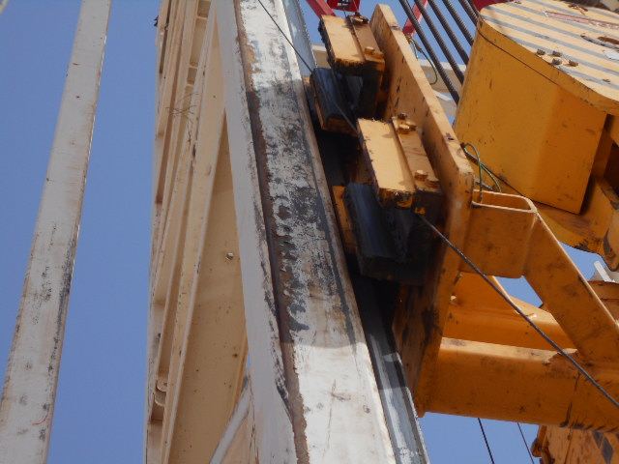
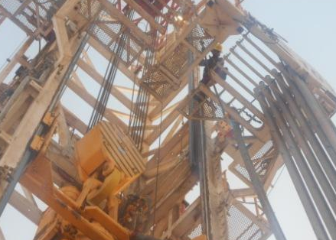
PDO Second Alert
Date: 17.06.2017 Incident: LTI
What happened?
During process of Derrickman (DM) changeover, Floorman (FM) relieved DM and pulled & racked back a stand of pipe. DM was standing close to ladder with fall arrester attached in preparation to descend down the ladder. Driller lowered Top Drive System (TDS) which entangled and pulled the fall arrester line along with DM. DM fell (same level) at monkey board platform with left leg trapped between monkey board post & guide beam resulting in a fracture to his left ankle.
Your learning from this incident..
Always ensure the TDS is stationary until DM changeover is complete
Ensure communication between Driller and DM at all times
Ensure right Fall Arrester is used at all times
Block moving
Block moving at monkey board level during changeover
Always ensure travelling block is stationary during DM changeover
Block stationary at Rig Floor level during changeover

Slide 2
Management self audit
Date: 17.06.2017 Incident: LTI
As a learning from this incident and ensure continual improvement all contract
managers must review their HSE HEMP against the questions asked below
Confirm the following:
Do you have a Derrickman Changeover procedure in your company? Does it mention that the block should be stationary at the time of DM changeover?
Did you evaluate the possibility of use of Lad-Safe on your Derricks?
Do you have Rescue from Height procedure in your company?
Do you hold Drills for Rescue from Height?
Do you apply consequence management where necessary?
Do you ensure adequate competency levels for all staff?
Notes:
Make a list of closed questions (only ‘yes’ or ‘no’ as an answer) to ask other contractors if they have the same issues based on the management or HSE-MS failings or shortfalls identified in the investigation. Pretend you have to audit other companies to see if they could have the same issues.

