Slide 1
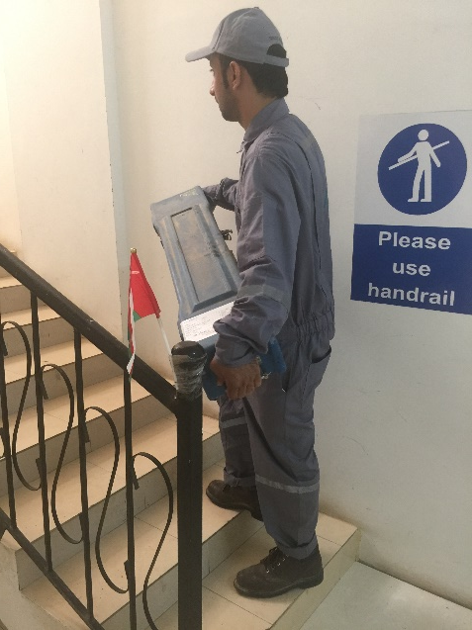
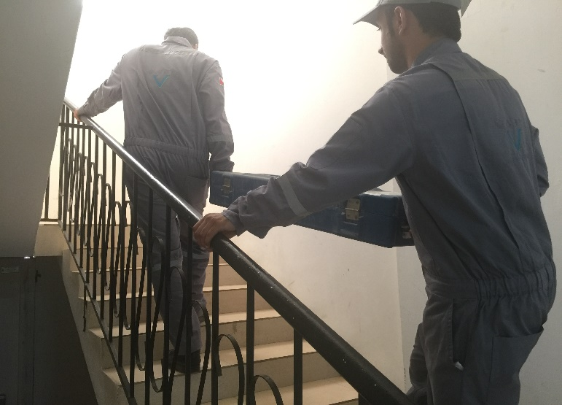
PDO Second Alert
Date: 22.06.17 Incident : LTI
What happened?
While and Engineer was carrying a cylinder up the stairs, his left foot slipped and he lost balance. The steel cylinder struck his left hand against the stair step and the other side of the cylinder struck the right hand against the stair floor resulting in several cuts and a fracture to his left hand ring finger.
Your learning from this incident..
Always ensure you follow manual handling procedures
Always ensure you ask for help if a load is heavy or awkward in shape
Always STOP if you see an unsafe action or condition and report it immediately
Carrying cylinder on stairs unaided and without holding hand rails.
Two people to carry cylinder on stairs while holding hand rails.
Empower ALL team members to STOP any unsafe act.

Slide 2
Management self audit
Date: 22.06.17 Incident : LTI
As a learning from this incident and ensure continual improvement all contract
managers must review their HSE HEMP against the questions asked below
Confirm the following:
Do you empower ALL your staff to intervene and STOP any unsafe act?
Do you ensure that your staffs are following correct procedures when carrying out tasks?
Do you ensure all procedures are up to date and staffs have read and understood them?
Notes:
Make a list of closed questions (only ‘yes’ or ‘no’ as an answer) to ask other contractors if they have the same issues based on the management or HSE-MS failings or shortfalls identified in the investigation. Pretend you have to audit other companies to see if they could have the same issues.

